Slide 1
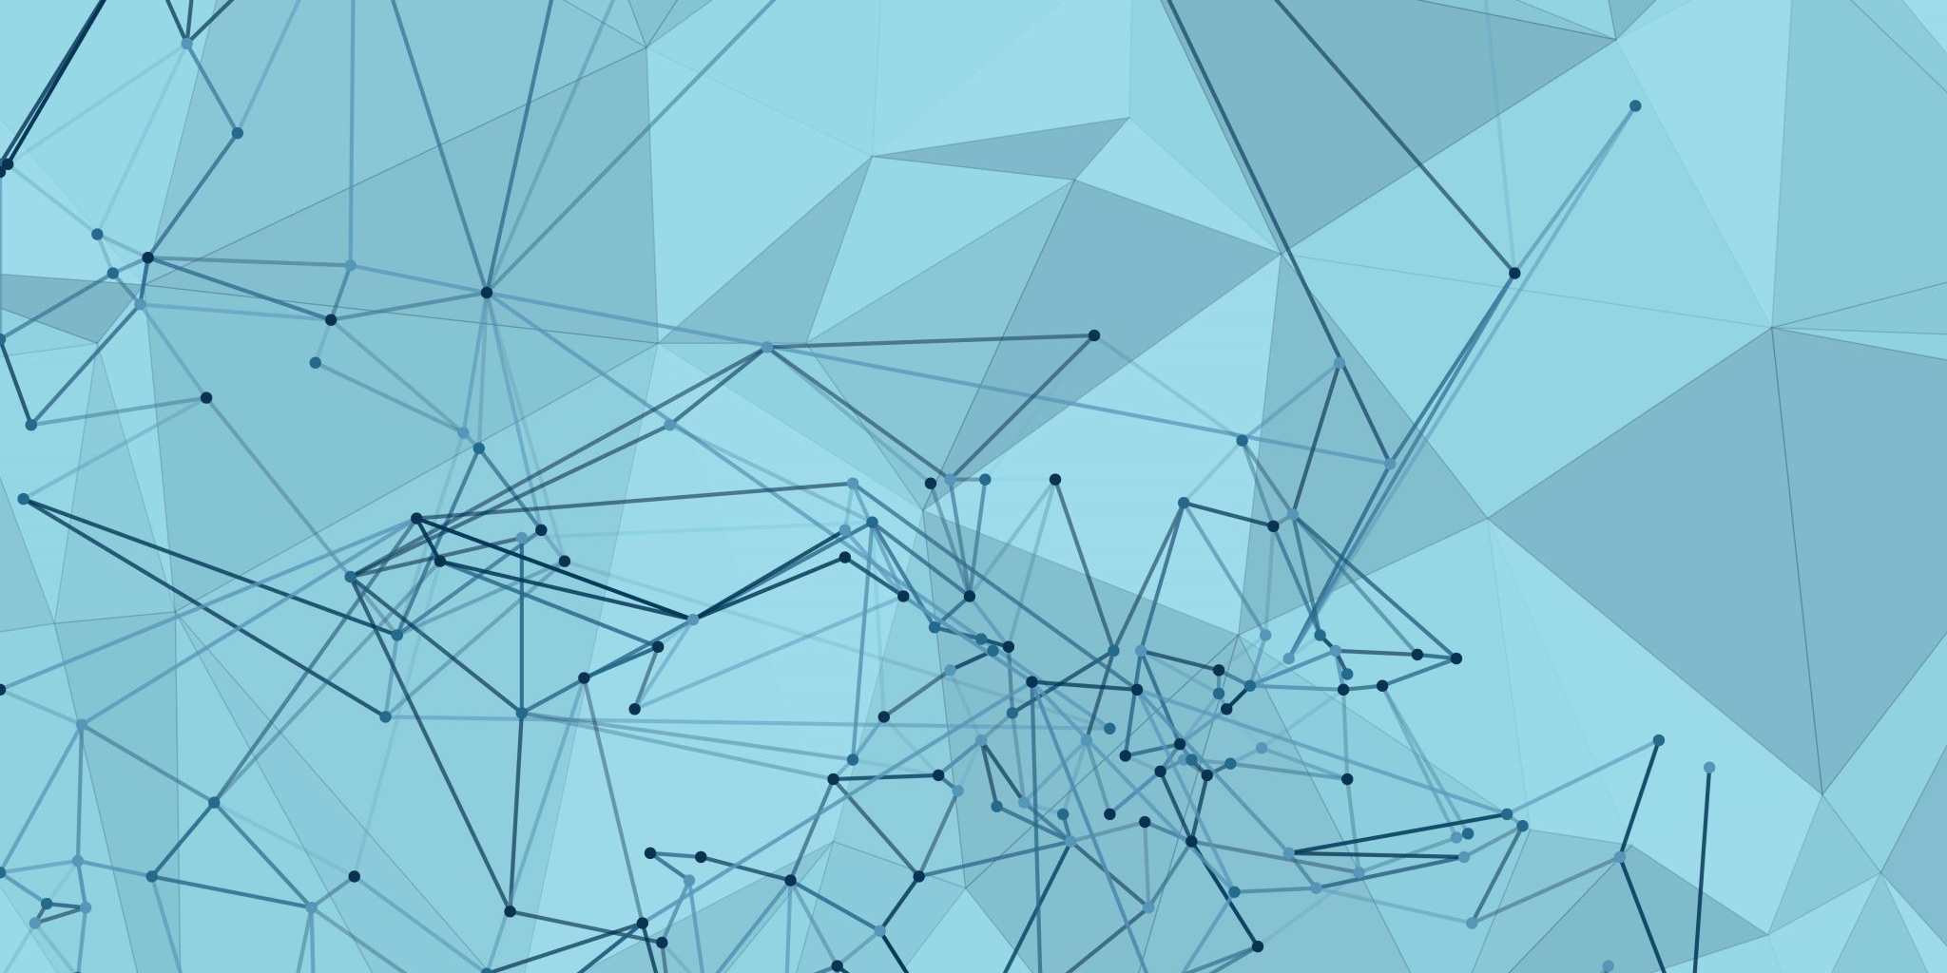
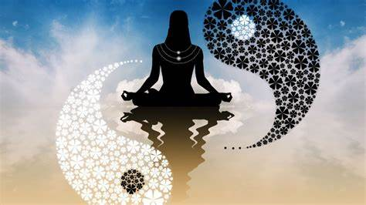
Ennealogy
Omniscence: Know Thyself
Created by Michael Farnum

Slide 2
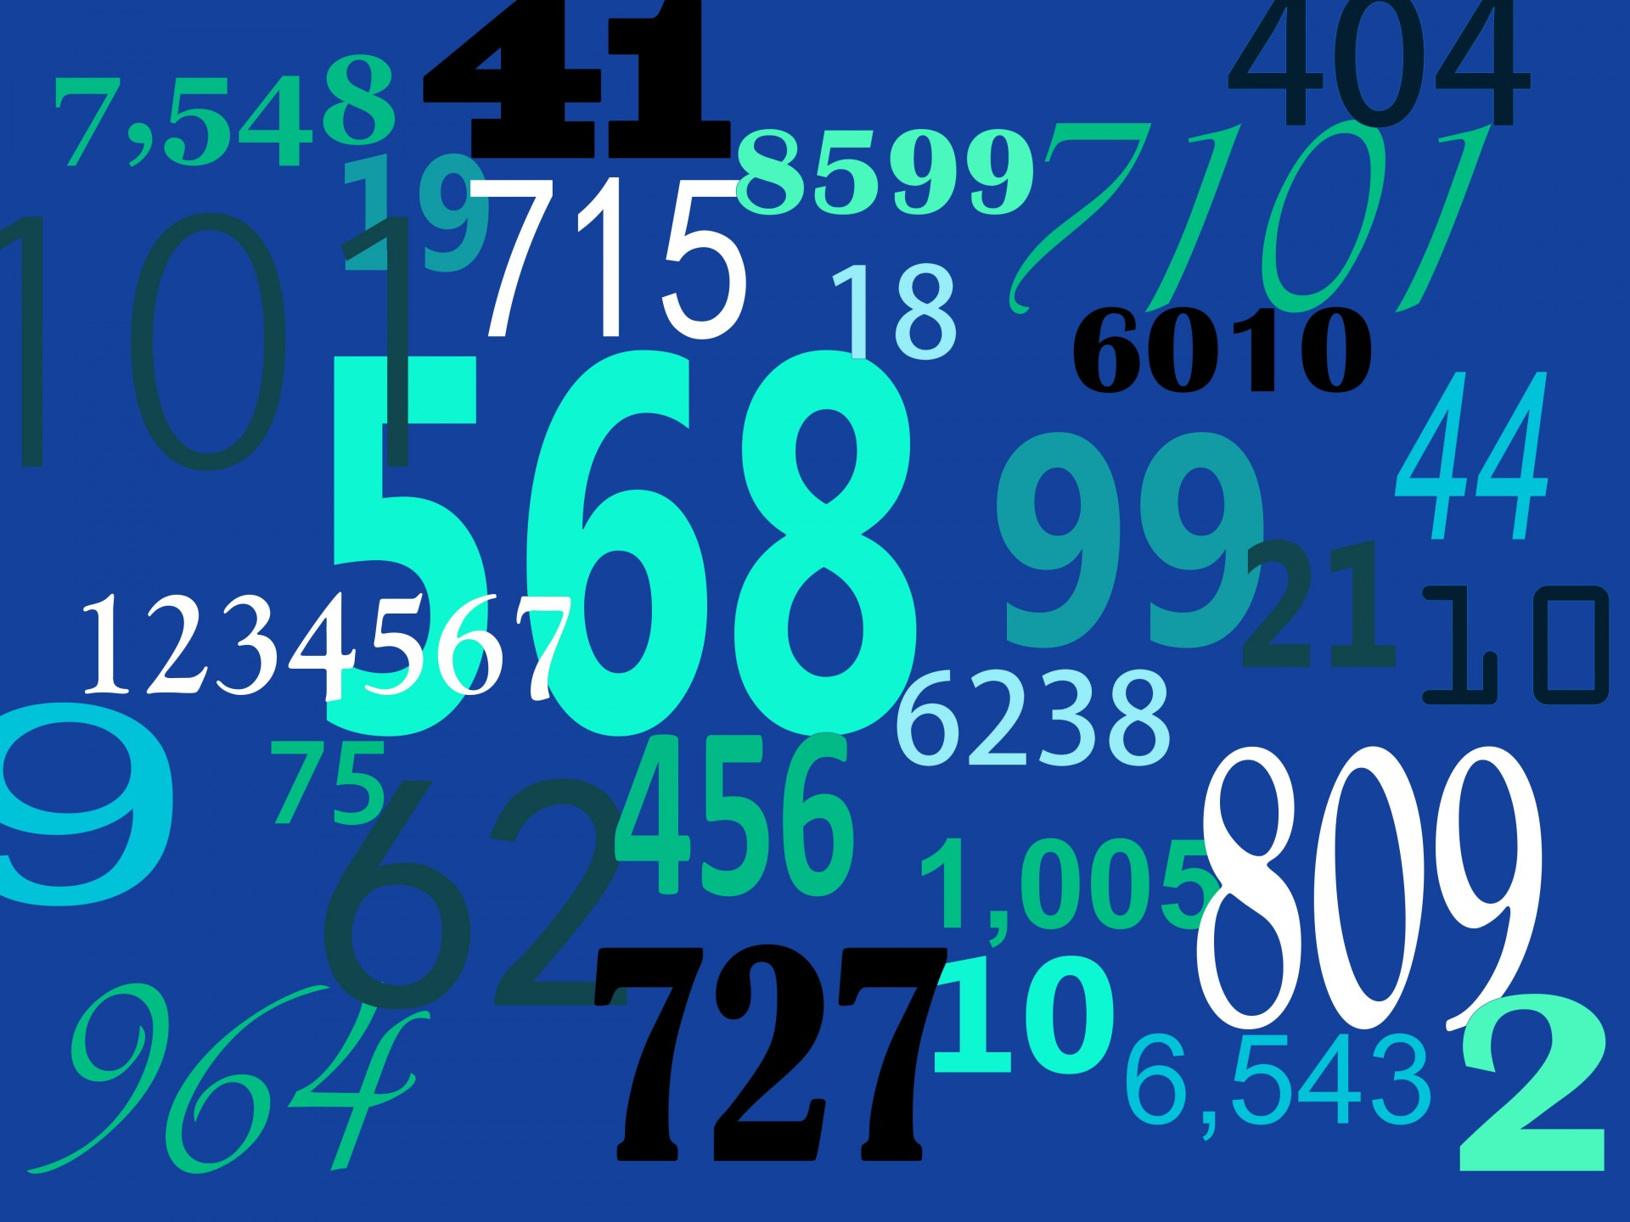
Ennealogy is an ancient science, a
form of numerology associated w/
astrology.
The Enneagram is a model of the
human psyche.
We can use Ennealogy to determine our personality type.
It is taught that there are 9 essential personality types describing how people interpret the world and manage their emotions.

Slide 3
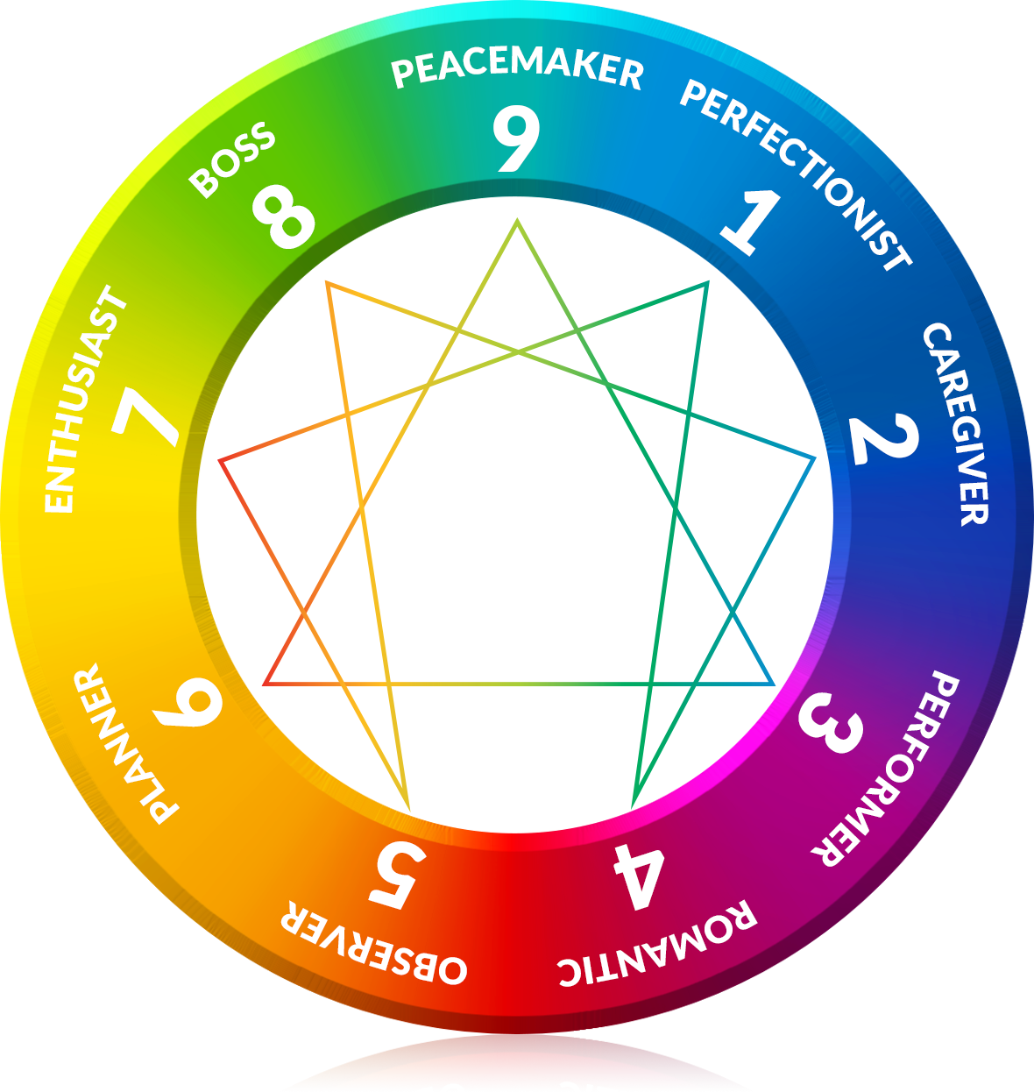
Within the circle there is a path of Integration or Growth, as in 1 to 7 and so on.
Or the reverse, a path of Disintegration or Stress as from 1 to 4 and so on.
The integrated person completes the circle.

Slide 4
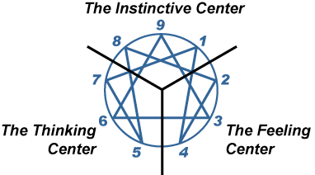
Anger
Fear
shame

Slide 5
Type One is principled, purposeful, self-controlled, and perfectionistic.
Type Two is generous, demonstrative, people-pleasing, and possessive.
Type Three is adaptable, excelling, driven, and image-conscious.
Type Four is expressive, dramatic, self-absorbed, and temperamental.
Type Five is perceptive, innovative, secretive, and isolated.
Type Six is engaging, responsible, anxious, and suspicious.
Type Seven is spontaneous, versatile, acquisitive, and scattered.
Type Eight is self-confident, decisive, willful, and confrontational.
Type Nine is receptive, reassuring, complacent, and resigned.

Slide 6
Start here.
Draw three lines of numbers from 1 to 9.
Core desires & fears:
2 3 4 5 6 7 8 9
1 2 3 4 5 6 7 8 9
1 2 3 4 5 6 7 8 9
Your basic orientation:
Centers of intelligence

Slide 7
The top row represents your core desires and fears.
Which one do you spend a lot of time thinking about, acting out or doing something about?
Core desire: To be good and have integrity. Core fear: To be bad, defective, imbalanced, or corrupt.
Core desire: To feel loved and needed.
Core fear: Being unloved or unlovable.
3. Core desire: To feel valuable and be successful. Core fear: Feeling worthless or being useless.

Slide 8
Core desire: To be yourself. Core fear: To have no significance.
Core desire: To be capable and competent. Core fear:
To be incompetent or helpless.
6. Core desire: To have support, security and guidance. Core fear: To be w/o support.
Core desire: To be satisfied and have freedom. Core fear: Being trapped or deprived of pleasure.
Desire: To protect yourself and loved ones. Fear: To be harmed or controlled.
Desire: To have peace of mind and wholeness. Fear: Loss, separation, conflict.

Slide 9
3 Basic Stances: Future, present, past.
1. You look towards the future. You like to build things and plan things. You feel as if others are moving too slow and can’t keep up with your energy. Circle 3,7,8.
2. You want to do things well. You worry that you may not be doing them as well as you should. You’re very aware of pleasing others. You depend on feedback. You focus on what needs to be done now. Circle 1, 2 and 6.
3. You like to sit back, observe and reflect. You are sentimental, daydream, and feel slightly detached from your surroundings. Circle 4, 5, 9.

Slide 10
Centers of Intelligence
This Photo by Unknown Author is licensed under CC BY-NC
How would you react if you just got a bit of bad news?
1. Shame, heartbreak, taking the blame. Circle 2,3,4
Respond in fear, confusion, self-protection, figuring out what to do. Circle 5,6,7
3. Angry, moved to action. Circle 8, 9, 1.

Slide 11
Alternate method to determine your psychic number:
What day were you born on?
Ex. Dec. 9. If a 2-digit number, add together to make a single digit.
(22 = 4)

Slide 12
The Sun: Pioneer or Perfectionist
1
Associations: Gold, copper, the heart, energy, fame, courage, Sunday
People from the Sun are natural leaders with very strong personalities that don’t let them hide in the shadows. These people are enthusiastic, quick to act, and businesslike.
You may get angry easily, find it hard to calm down. You may be moody and be prone to headaches.

Slide 13
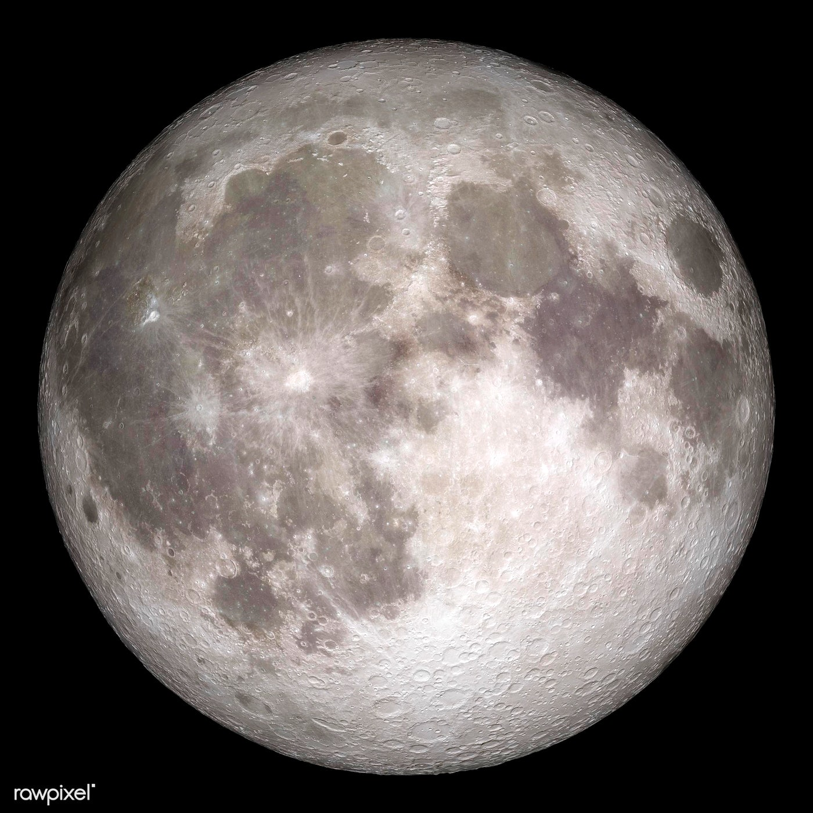
2
The Moon: The Mystic helper
Associations: Water, mirrors, travel, diplomacy, Monday
Moon people have different feelings and are more open to them though tend to be introverted. You are adaptable, opportunistic, and tend to avoid conflict. You are loyal, sensitive and rarely take chances. You tend to be moody, possessive and seek out the strong for support.
Your moods may be volatile and unpredictable during a full moon.

Slide 14
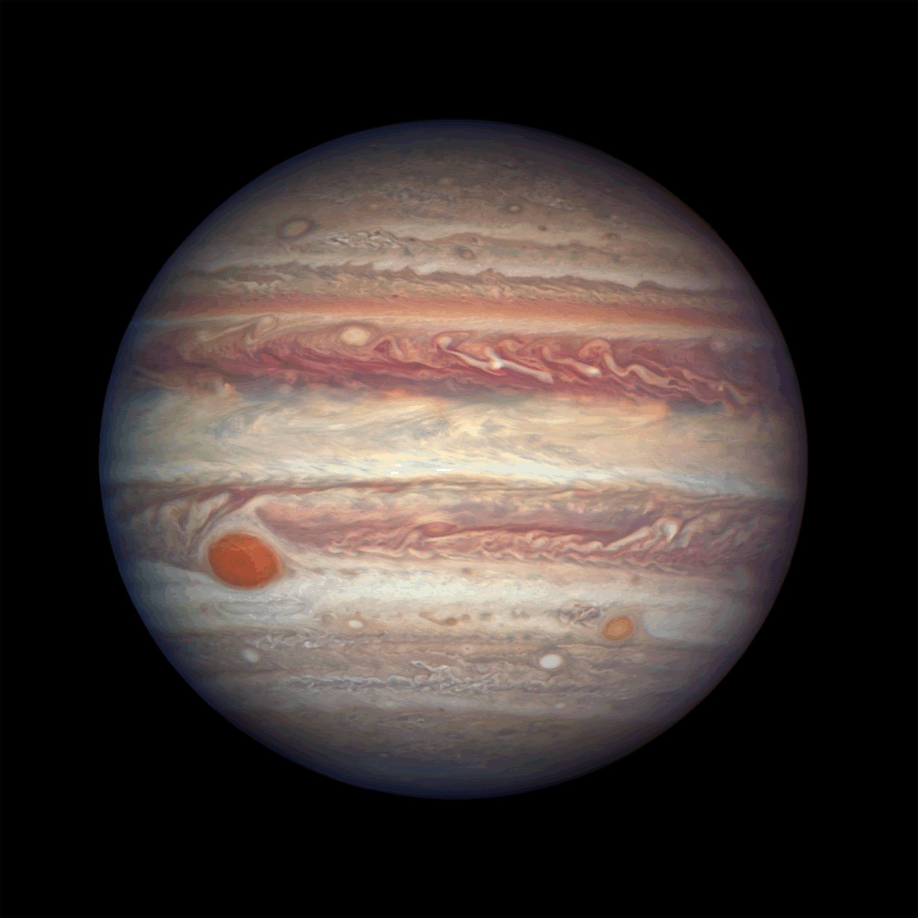
3
Jupiter: The Driven
This Photo by Unknown Author is licensed under CC BY-SA
Associations: Authority, father figures, humor, noise, justice, materialism
Most people from Jupiter are optimistic and have a good attitude toward others and themselves. They usually have a deep understanding of who they are, give love to others, and expect respect in return.
They don’t argue over small things, avoid hard situations and fights, and often act like magnets, bringing happiness and peace to themselves. The way they think helps them reach their goals. People under this number feel responsible, want to improve themselves, are influenced by idealism, have trouble making decisions, and want to be noticed. In general, you are outgoing and love to be the center of attention. You tend to be attracted to the material realm.

Slide 15
4/9
Uranus: Rebel or Romantic?
This Photo by Unknown Author is licensed under CC BY
Associations: Rebellion, mystery, silence, upheaval and violent change, cold, the occult
You are very stubborn and don’t follow the rules. You do things your own way. You try to make changes in society and turn away from the past. Uranus people are kind, independent people who don’t follow the rules.
You try to make as many friends as you can, are interested in spirituality, and love and respect nature. Even though the people of Uranus are independent, they are not closed off and don’t mind being around other people.

Slide 16
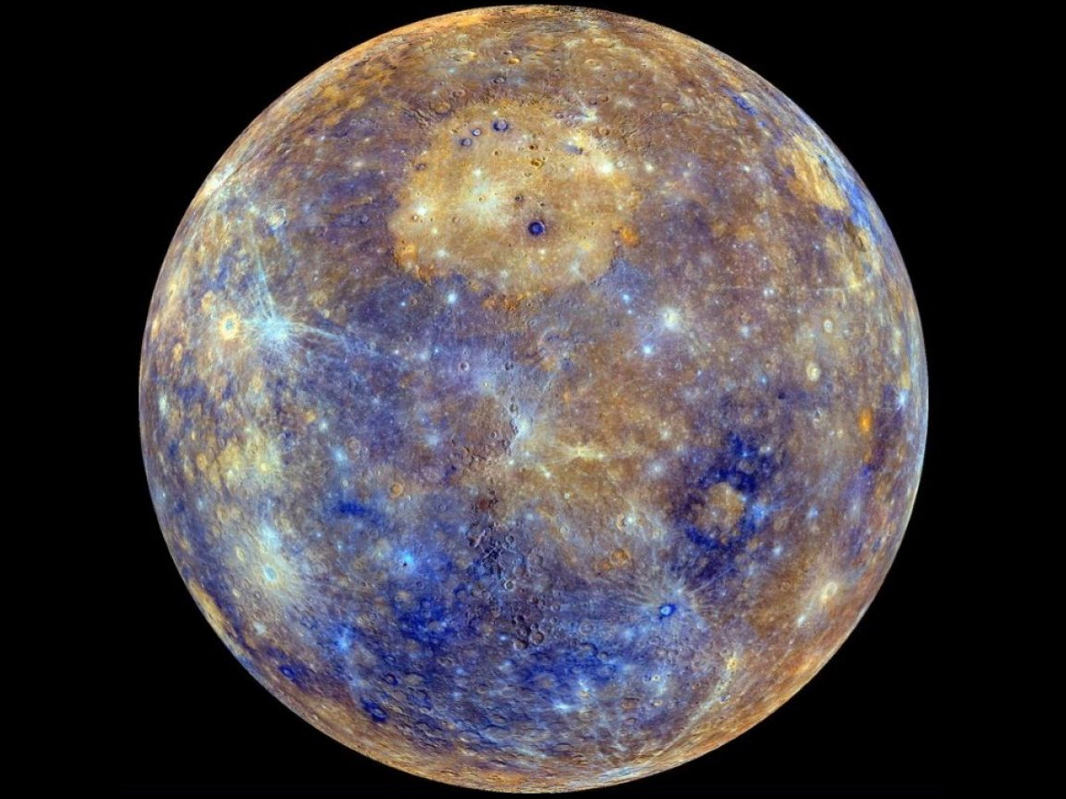
Mercury: The Networker
5
This Photo by Unknown Author is licensed under CC BY-NC-ND
Represents communication, signals, technology, networking, speed, Hermes, business, trade, philosophy, Wednesday
People with this sign have a very active and unique way of thinking. They take the lead in everything, and if they don’t, they quickly find a good reason. They often try to test their strength in jobs that aren’t common. You are probably good with money, you are charming and interested in all aspects of life. You tend to be short-tempered.

Slide 17
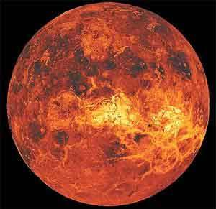
Venus: Lover
6
Associations: Love, romance, beauty, mystery, art, creativity, power, music, cars, sports, addiction, Friday
This Photo by Unknown Author is licensed under CC BY-ND
People with this sign give off an air of sensuality, and everyone loves them. Their charm helps them avoid all the bad things that can happen in life. Since they get everything easily, they have to be very careful with money or they could lose a lot of it.
All of life’s problems are easy for them to get around because of their charm. Venus people use love and charm to get what they want in life, and they often marry someone who is richer and can take care of them.

Slide 18
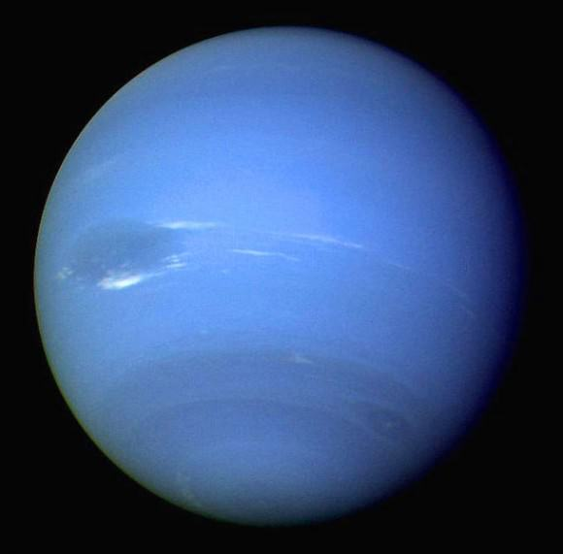
7
Neptune: The Psychic
Associations: The Moon, sensitivity, intuition, the psyche, the unconscious, healing, Tuesday
This Photo by Unknown Author is licensed under CC BY
Connected to the Moon, people from Neptune get along well with the second type. Most of the time, they are philosophical or religious, and they have a character that makes them easy to get along with.
Money often falls apart in your hands like snow, leaving you in a bad financial situation. You have good ideas, but rarely follow them through to the end. You like to play the odds. Neptune people tend to be soft, sensitive personalities who are kind and aware of how others are feeling.

Slide 19
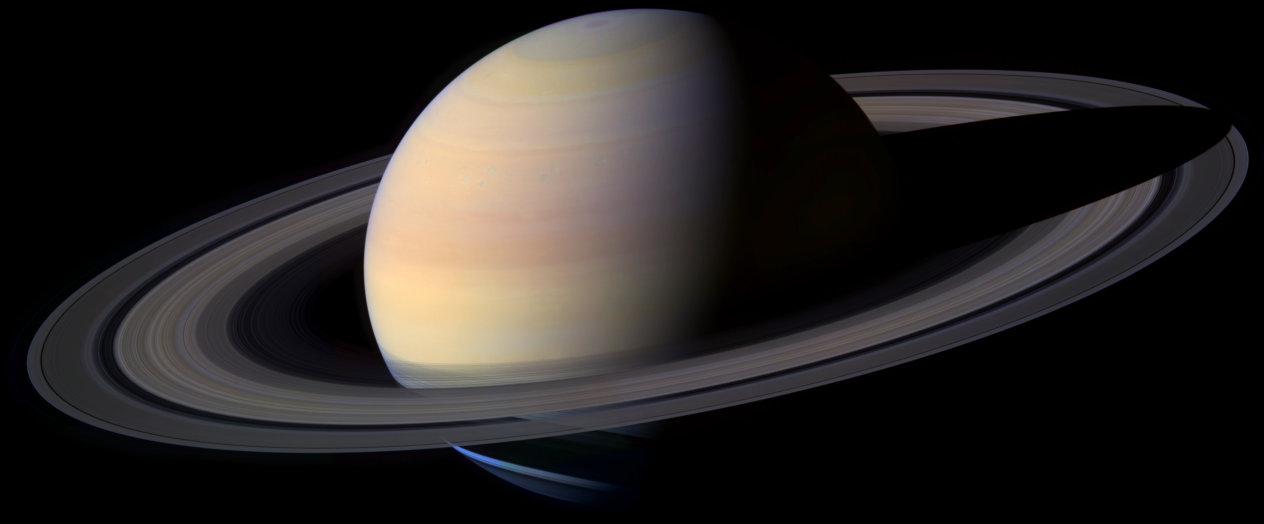
8
Saturn:
The Boss
This Photo by Unknown Author is licensed under CC BY-SA
Associations: The underworld, rules, law and order, memory, timelessness, security, financial stability, labor, farming, Saturday
People born under this sign are open-minded, but they don’t get along with other people very well and often feel lonely. Their coldness and isolation on the outside hide the fact that they want spiritual warmth but don’t know how to show it. You are stubborn, realistic, and usually don’t have to answer to anyone. You can be skeptical and may have trust issues.

Slide 20
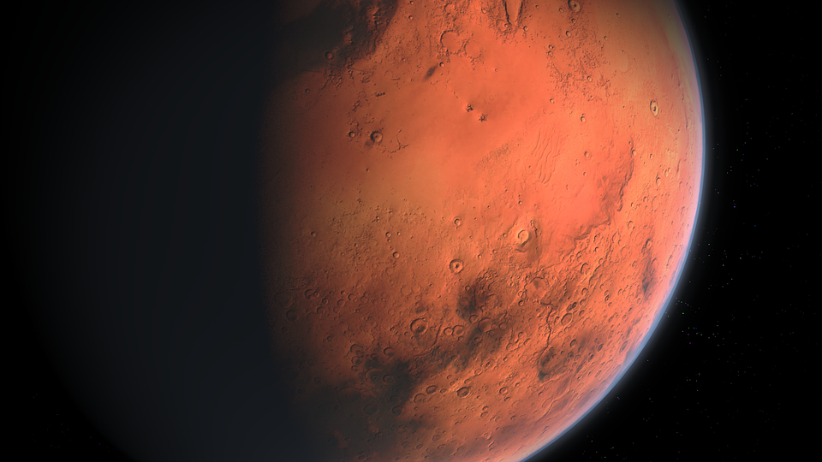
/
9/4
Mars: Warrior
Associations: War/peace, aggression, apocalypse, judgment, strength, anger, iron, metal, fire
The people of Mars are ready to take over by themselves. They don’t listen to reasons why something shouldn’t be done. They have courage and a strong will, and because of these things, they do very well.
But their actions are hurt by their tendency to act on impulse. Most of the time, they don’t weigh their strengths and don’t use them in a smart way. They often have problems with love and relationships because they are too proud.
They have good organizational skills and will not put up with being in a lower position. If they had used their strengths and skills on purpose, they could have done very well. So, the only way to tell them apart is by their initiative, energy, and ability to do things on their own.

Slide 21
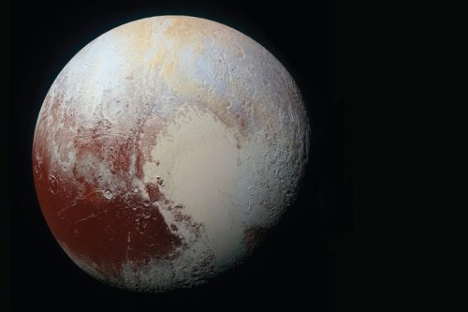
Pluto: Peacemaker/
Transformer
0
This Photo by Unknown Author is licensed under CC BY-SA-NC
Pluto or zero balances the male/female distribution of zodiacal energy in modern times and is one reason why Pluto is having difficulty becoming accepted in our still male-dominated society.
You are compassionate and selfless.
Pluto’s energy may be subtle, but its results will hit you like a ton of bricks. This planet is about transformation, regeneration and rebirth. Things aren’t pretty with Pluto, but they do get done. Pluto says ‘out with the old and in with the new,’ and we’d better be ready for it. If we’re not, this planet will simply have us wallow in our misery. Pluto asks us to transcend that which we know, redeem ourselves in the process, and come out stronger as a result.

Slide 22
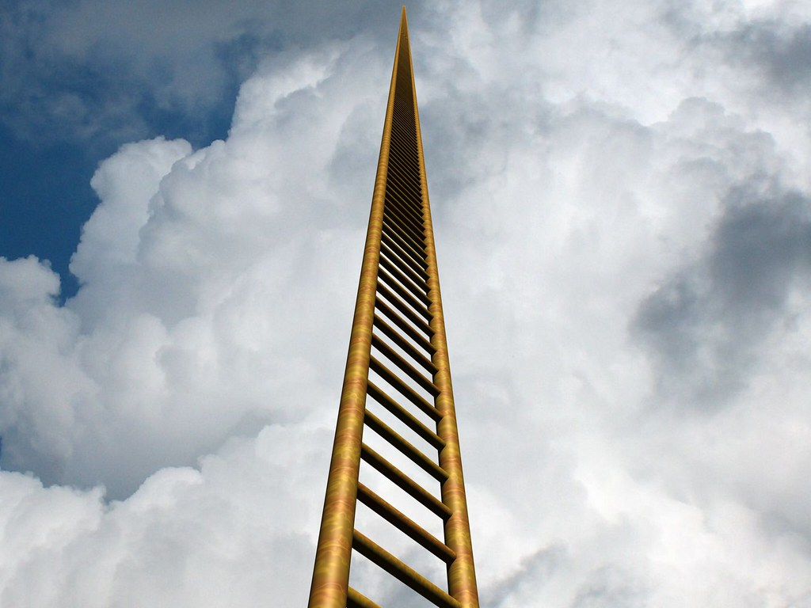
To understand an individual accurately, it is necessary to perceive where the person lies along the continuum of Levels within his or her type at a given time.
In other words, one must assess whether a person is in their healthy, average, or unhealthy range of functioning
This Photo by Unknown Author is licensed under CC BY
Notes:
The Levels of Development
There is an internal structure within each personality type. That structure is the continuum of behaviors, attitudes, defenses, and motivations formed by the nine Levels of Development which make up the personality type itself. This discovery (and the working out of all the traits that comprise each type) was originally made by Don Riso in 1977, and was further developed by Don with Russ Hudson in the 1990s. They are the only Enneagram teachers to include this important factor in their treatment of the Enneagram. The Levels are an important contribution not only to the Enneagram but to ego psychology — and the personality types of the Enneagram cannot be adequately explained without them. The Levels account for differences between people of the same type as well as how people change both for better or worse. Thus, they can also help therapists and counselors pinpoint what is actually going on with clients and suggest solutions to the problems they are having.

Slide 23
The Continuum of the Levels of Development
Healthy
Level 1: The Level of Liberation
Level 2: The Level of Psychological Capacity
Level 3: The Level of Social Value
Average
Level 4: The Level of Imbalance/ Social Role
Level 5: The Level of Interpersonal Control
Level 6: The Level of Overcompensation
Unhealthy
Level 7: The Level of Violation
Level 8: The Level of Obsession and Compulsion
Level 9: The Level of Pathological Destructiveness
Notes:
The Levels of Development
There is an internal structure within each personality type. That structure is the continuum of behaviors, attitudes, defenses, and motivations formed by the nine Levels of Development which make up the personality type itself. This discovery (and the working out of all the traits that comprise each type) was originally made by Don Riso in 1977, and was further developed by Don with Russ Hudson in the 1990s. They are the only Enneagram teachers to include this important factor in their treatment of the Enneagram. The Levels are an important contribution not only to the Enneagram but to ego psychology — and the personality types of the Enneagram cannot be adequately explained without them. The Levels account for differences between people of the same type as well as how people change both for better or worse. Thus, they can also help therapists and counselors pinpoint what is actually going on with clients and suggest solutions to the problems they are having.

Slide 24
One of the most profound ways of understanding the Levels is as a measure of our capacity to be present.
The more we move down the Levels, the more identified we are with our ego and its increasingly negative and restrictive patterns.

Slide 25
The Direction of Disintegration or Stress
for each type is indicated by the sequence of numbers 1-4-2-8-5-7-1. This means that an average to unhealthy One under stress will eventually behave like an average to unhealthy Four; an average to unhealthy Four will act out their stress like an average to unhealthy Two; an average to unhealthy Two will act out under stress like an Eight, an Eight will act out under stress like a Five, a Five will act out like a Seven, and a Seven will act out like a One. (An easy way to remember the sequence is to realize that 1-4 or 14 doubles to 28, and that doubles to 57—or almost so. us, 1-4-2-8-5-7—and the sequence returns to 1 and begins again.) Likewise, on the equilateral triangle, the sequence is 9-6-3-9: a stressed out Nine will act out like a Six, a stressed out Six will act out like a Three, and a stressed out Three will act out like a Nine.

Slide 26
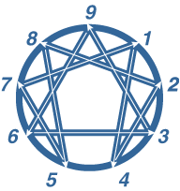
The Direction of Disintegration or Stress

Slide 27
The Direction of Integration or Growth
is indicated for each type by the reverse of the sequences for disintegration. Each type moves toward integration in a direction that is the opposite of its unhealthy direction. Thus, the sequence for the Direction of Integration is 1-7-5-8-2-4-1: an integrating One goes to Seven, an integrating Seven goes to Five, an integrating Five goes to Eight, an integrating Eight goes to Two, an integrating Two goes to Four, and an integrating Four goes to One. On the equilateral triangle, the sequence is 9-3-6-9: an integrating Nine will go to Three, an integrating Three will go to Six, and an integrating Six will go to Nine. You can see how this works by following the direction of the arrows on the following Enneagram.

Slide 28
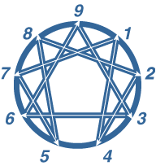
The Direction of Integration or Growth

Slide 29
The 3 Instincts:
Self-preservation
Sexual attraction
Social adaptive
Notes:
How The System Works — The Enneagram Institute

Slide 30
Ultimately, the goal is for each of us to “move around” the Enneagram, integrating what each type symbolizes and acquiring the healthy potentials of all the types. The ideal is to become a balanced, fully functioning person who can draw on the power (or from the Latin, “virtue”) of each as needed. Each of the types of the Enneagram symbolizes different important aspects of what we need to achieve this end.
The personality type we begin life with is therefore less important ultimately than how well (or badly) we use our type as the beginning point for our self-development and self-realization.

