Slide 1
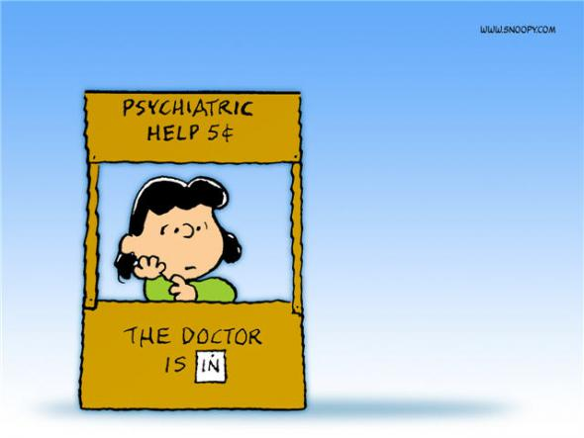
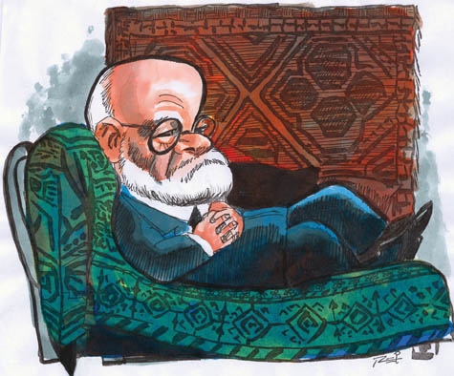
Bad Therapy
This Photo by Unknown Author is licensed under CC BY
This Photo by Unknown Author is licensed under CC BY
The Worst Things Your Therapist Could Say . . .
A Little Mental Health Comic Relief.
Michael V Farnum
7/20/24

Slide 2
So, what can tell me about your relationship with your Mother?
This Photo by Unknown Author is licensed under CC BY-ND
This Photo by Unknown Author is licensed under CC BY-NC-ND

Slide 3
Notes:
Blade Runner - Voight-Kampff Test (HQ

Slide 4
Tell me about your sexual problems . . .

Slide 6
Yeah, things will probably get worse before they get better . . .
This Photo by Unknown Author is licensed under CC BY-NC

Slide 7
Notes:
JOKER (2019)- movie therapy scene HD blue ray

Slide 8
You haven’t done your homework, have you? . . .

Slide 9
I’m sorry. I really don’t think I can help you two . . .

Slide 10
Notes:
Couples Retreat (9/10) Movie CLIP - Couples Therapy (2009) HD

Slide 11
You’re just a hot mess, aren’t you, mama?
This Photo by Unknown Author is licensed under CC BY-NC-ND

Slide 12
Notes:
Danzig - Mother ( Official Music Video )

Slide 13
You want to get a coffee? . . .

Slide 14
Notes:
ASMR inappropriate THERAPY SESSION 👀💜 asking YOU questions, focus on me, roleplay 4 sleep & giggles

Slide 15
Do you really want my advice???

Slide 16
In real life, bad therapy is no laughing matter. If you’ve been the victim of inappropriate therapy or as a therapist have an episode of bad therapy to confess, contact your state licensing board and seek professional legal advocacy as soon as possible.

Slide 17
Thank You!
Michael V. Farnum
Phone
219-221-3102
Email
mrfreeze1@yahoo.com

