Slide 1
The Psychology of Traps
This Photo by Unknown Author is licensed under CC BY
A trap is any situation we find ourselves in, entered into by our own choice, which has led to real or perceived negative or other unfortunate consequences.
True, often we are led, misled or deceived into traps, but ultimately the responsibility to get out lies with us.
The traps we find ourselves in can be described
as a mirror of our own interior emotional
or mental landscape, a shadowy reflection of
our own fears and desires.
Fortunately, most traps are not catastrophic.

Slide 3
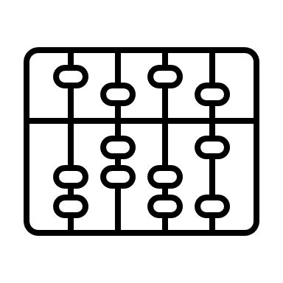
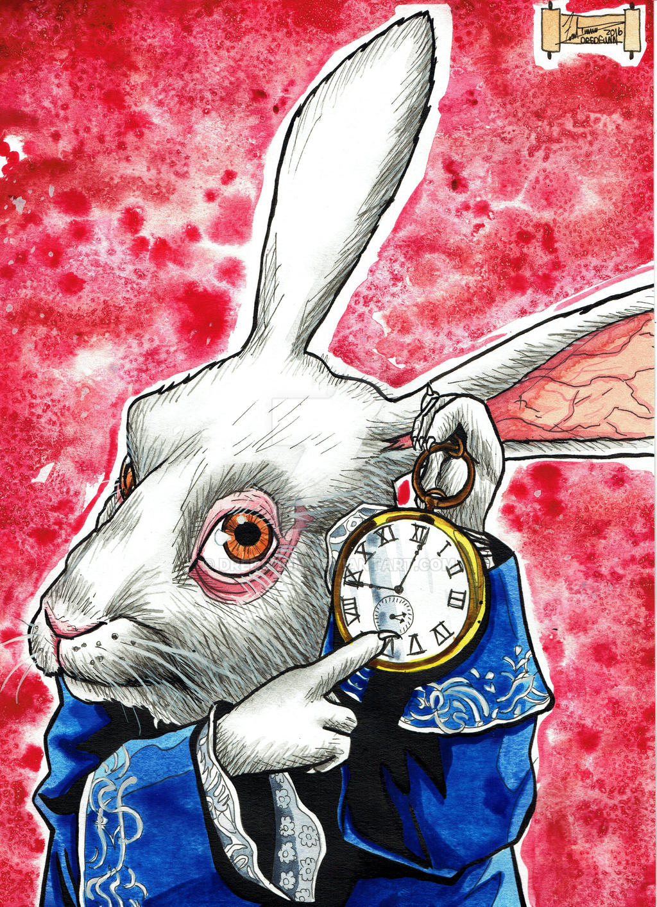
Anything can be a trap . . .
This Photo by Unknown Author is licensed under CC BY-NC-ND
This Photo by Unknown Author is licensed under CC BY-NC-ND
This Photo by Unknown Author is licensed under CC BY

Slide 4
Honey trapping is a so-called investigative practice involving the use of romantic or sexual relationships for interpersonal, political (including state espionage), or monetary purpose.
The Science of Espionage:
Money
Ideology
Compromise
Ego
Notes:
CHARNEY_and_IRVIN_Psychology_of_Espionage_from_AFIO_INTEL_SPRING2016_Vol22_no1.pdf

Slide 5
Notes:
“Just Like Honey” by Jesus and Mary Chain

Slide 6
Common Traps: The Authority Bias
Placing ones faith in some nebulous authority
figure is a trap most people fall into
as part of our social programming.
Conveniently, this absolves
us of independent and critical
thinking, which most people
Hate, apparently.
Thinking, that is.
Authority is a false construct.
The only true “authority”
Is logic, common sense
and wisdom.
Trust the experts?
Trust the science? . . .
Convenient also for the authority figures, who can’t have the common man thinking for him/herself . . .

Slide 7
Evading Traps
Realize there is nothing for free.
Nothing good comes easy.
Don’t fall for the things you want to hear.
Consider the true value of a thing.
Never act out of desperation or in a state of high emotionality.
Don’t believe everything you believe.
Know that anything can be a trap.
What’s popular is not true; what’s true is not popular.
Recognize your traps. Learn from your experiences.
Read more books.
Don’t be a nube.

Slide 8
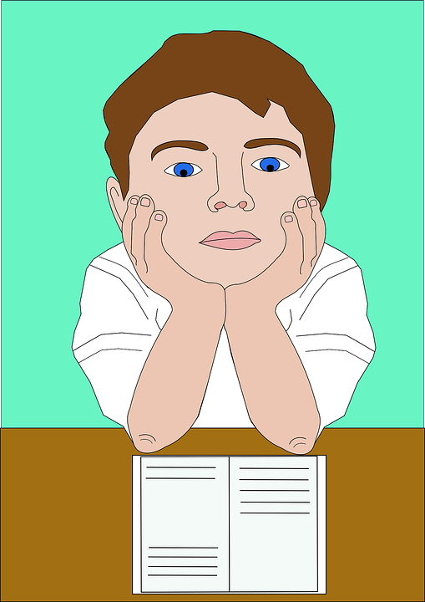
Exercise: Recognizing Your Traps
Think of 10 Traps you have fallen into in your life.
What traps have you found yourself susceptible to?
The Trap | What led you to this trap? | What did you learn?
Ask other people about the traps they have fallen into. What did they learn? How can you avoid the same traps?

Slide 9
Buddha found out that there was no trap to get out of except for himself. Trap and trapped are one, and when you understand that, there isn't any trap left."
~Alan Watts

Slide 11
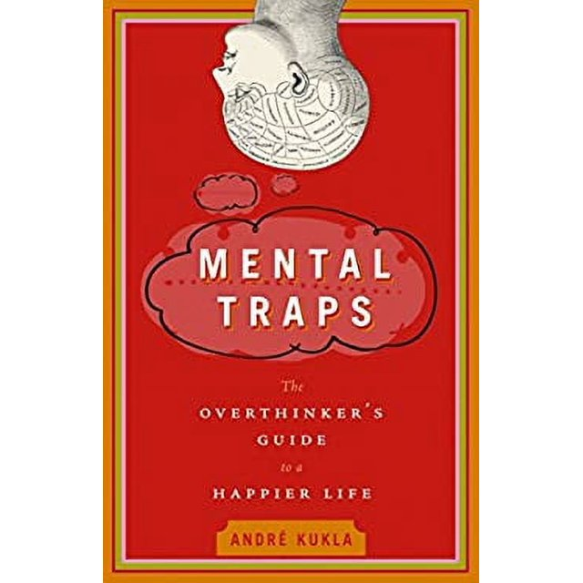
Sources
2:04:53 / 2:57:24
250 Traps Of Life - The Psychology Of Traps
250 Traps Of Life - The Psychology Of Traps - YouTube

