Slide 1
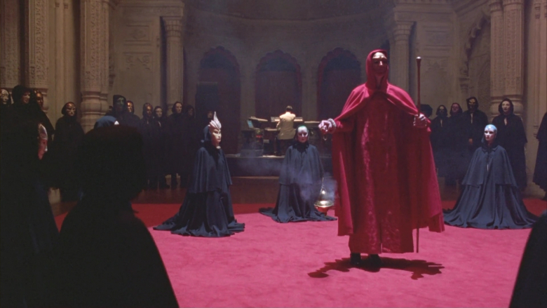
Departed or Silenced Truthers & Why They Were Silenced, allegedly
From Eyes Wide Shut, 1999
Michael V Farnum (2021)
Notes:
This presentation was done in part to honor the following intrepid individuals: Otto Binder, Ron Bonds, Isaac Cappy, Danny Casolaro, Morris Jessup, Ron Johnson, Jim Keith, Ann Livingstone, Dr James McDonald, David McGowan, Ron Rummel, Ivan T. Sanderson, Philip Schneider, Frank Scully, Max Spiers, Granger Taylor, Garav Turawi, Tracy Twyman, Gary Webb. Please forgive any unintentional omissions or misspellings.
Image source: Alice Down the Rabbit Hole, https://www.machiasnews.com/lewis-carroll%E2%80%99s-alice-down-rabbit-hole

Slide 2
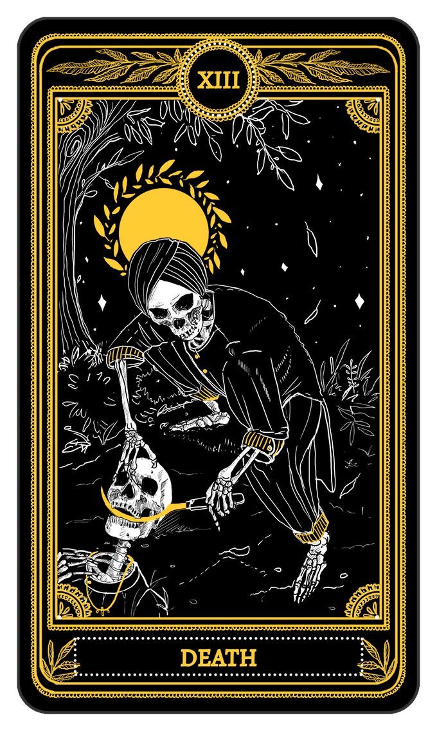
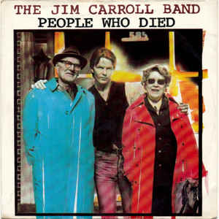
A brief tribute to the Jim Carroll Band and their infamous song:
“Those are people who died, died . . . “
“They were all my friends . . . And they died . . .”
From the album “Catholic Boy”, 1980.
YouTube: https://www.youtube.com/watch?v=tf4d7VxcQ30
Notes:
Images source, Death Card, Marigold Tarot, https://mywanderingfool.com/tarot/tarot/marigold-tarot/death-card-marigold-tarot/

Slide 3
Why?
When one really digs into the research, it truly is uncanny how many true journalists, so-called conspiracy theorists, independent researchers, paranormal explorers, rogue scientists, would-be whistleblowers and other “truthers” have suffered such an anomaly of misfortunes, strange/unexplained deaths or otherwise seemingly
vanished without a trace . . .
Did they get too close to the truth?
Or did they just fall in with the wrong crowd?
Or (something we always have to consider) is it all just another psy-op?
(Source Fenster, 2008)
Notes:
Source:
Fenster, M. (2008). Conspiracy Theories: Secrecy and Power in American Culture. U. Of Minnesota Press.

Slide 4
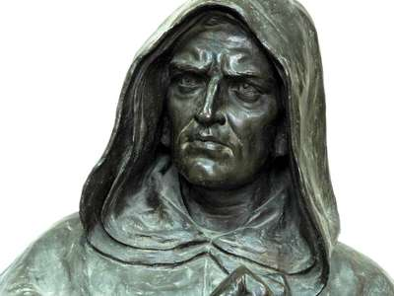
Giordano Bruno (1548-1600)
Dominican friar and Italian poet, philosopher, mathematician and astronomer
Proposed the infinite universe and the multiplicities of worlds
Rejected traditional geo-centric paradigm
Bruno’s theories made him a heretic to the Catholic church and others
Published Il candeleio (1582), The Candlemaker, a vivid representation of contemporary Neapolitan society and a protest or satire of the moral and social corruption of the time
Facing various trials for heresy, fled Naples for Rome, then to Geneva where he was eventually arrested, rehabilitated and excommunicated, leaving for France
Appointed to a lectureship in Paris
Moved to London and lectured at Oxford where he associated with royal elites
Published 6 Italian Dialogues, 3 cosmological, 3 moral
Described religion as a means to instruct and govern ignorant people; philosophy as the discipline of the elect who are able to behave themselves and govern others.
Represented the initial stage of modern civilization (Steiner, 1923).
A memory genius, developed a revolutionary mnemonic “memory wheel” which involved elaborate wheels of association and which he demonstrated for the Pope in Rome
Notes:
Sources:
https://www.britannica.com/biography/Giordano-Bruno
Struggle of Jacob Boehme, Giordano Bruno and Francis Bacon for New Knowledge By Rudolf Steiner
"Jacob Boehme, Giordano Bruno and Francis Bacon as Representatives of the Struggle to Discover a New Knowledge of Humanity and the Cosmos (Dornach, January 12, 1923)"
https://www.youtube.com/watch?v=CnonhozVlg8

Slide 5
Giordano Bruno (1548-1600)
Addressing his judges: “Perhaps your fear in passing judgment on me is greater than mine in receiving it.”
It remains a mystery whether Bruno was killed for his theological heresy or his cosmological beliefs. Were the ignorant masses being shielded from Bruno’s terrifying existential ideas?
Returned to Paris and a changed political atmosphere; engaged in polemic with high figures, now adversaries
Moved to Germany and wandered between various universities, publishing more works
1589, excommunicated by the Lutheran church
1591 returned to Italy, seeking Chair of Mathematics at Padua (it went to Galileo, later facing similar charges but recanting)
1592 was denounced by his Venetian patrons to the Venetian Inquisition (See Mocenigo).
1593, The Roman Inquisition demanded his extradition
Imprisoned for 7 years and defended himself in a lengthy trial but refused to repent
1600, Pope Clement VIII declared him an impenitent and pertinacious heretic, sentenced Bruno to death
Paraded before a crowd, his tongue skewered with a metal spike, he
was burned alive at Campe de Fiore in Rome.
Notes:
Sources:
https://www.britannica.com/biography/Giordano-Bruno
Struggle of Jacob Boehme, Giordano Bruno and Francis Bacon for New Knowledge By Rudolf Steiner
"Jacob Boehme, Giordano Bruno and Francis Bacon as Representatives of the Struggle to Discover a New Knowledge of Humanity and the Cosmos (Dornach, January 12, 1923)"
https://www.youtube.com/watch?v=CnonhozVlg8
Giordano Bruno and the Poem Worth Dying For
https://www.youtube.com/watch?v=d4eWqdwEMzk
https://www.youtube.com/watch?v=wy_OTBVvfKA

Slide 6
The Italian Dialogues of Bruno
Cena de le Ceneri (1584; “The Ash Wednesday Supper”): Reaffirmed the reality of the heliocentric theory, also suggested the universe is infinite, constituted of innumerable worlds substantially similar to those of the solar system.
Anticipating fellow Italian astronomer Galileo Galilei, maintained the Bible should be followed for its moral teaching but not for its astronomical implications. Strongly criticized the manners of English society and the pedantry of the Oxonian doctors. De la causa, principio e uno (1584; Concerning the Cause, Principle, and One) Elaborated the physical theory on which his conception of the universe was based: “form” and “matter” are intimately united and constitute the “one.” Thus, the traditional dualism of the Aristotelian physics was reduced by him to a monistic conception of the world, implying the basic unity of all substances and the coincidence of opposites in the infinite unity of Being. De l’infinito universo e mondi (1584; On the Infinite Universe and Worlds), Developed his cosmological theory, systematically criticizing Aristotelian physics; formulated his Averroistic view of the relation between philosophy and religion. The Spaccio de la bestia trionfante (1584; The Expulsion of the Triumphant Beast), the first dialogue of his moral trilogy, a satire on contemporary superstitions and vices, embodying a strong criticism of Christian ethics—particularly the Calvinistic principle of salvation by faith alone, to which Bruno opposes an exalted view of the dignity of all human activities. The Cabala del cavallo Pegaseo (1585; “Cabal of the Horse Pegasus”), similar to but more pessimistic than the previous work, includes a discussion of the relationship between the human soul and the universal soul, concluding with the negation of the absolute individuality of the former. In the De gli eroici furori (1585; The Heroic Frenzies), Bruno, making use of Neoplatonic imagery, treats the attainment of union with the infinite One by the human soul and exhorts man to the conquest of virtue and truth.
Notes:
Sources: https://www.britannica.com/biography/Giordano-Bruno

Slide 7
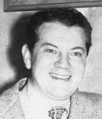
Otto Binder, UFO Investigator
(1911-1974)
Writer for SAGA magazine, comic and co-founder of Supergirl and Captain Marvel, writer for “The Outer Limits”
Author, “Liquidation of the UFO Investigators” (1971)
Bender researched the deaths of some 137 researchers, writers, scientists, and witnesses who had died in the previous decade under what many would consider suspicious circumstances.
“Liquidation” mapped out a pattern of deaths—apparent suicides, aggressive cancers, heart attacks and others among UFO researchers, whistleblowers and witnesses.
(
Notes:
Sources:
http://www.jamesoberg.com/binder.otto.pdf
http://www.metatech.org/ufo_research_magazine_evidence.html,

Slide 8
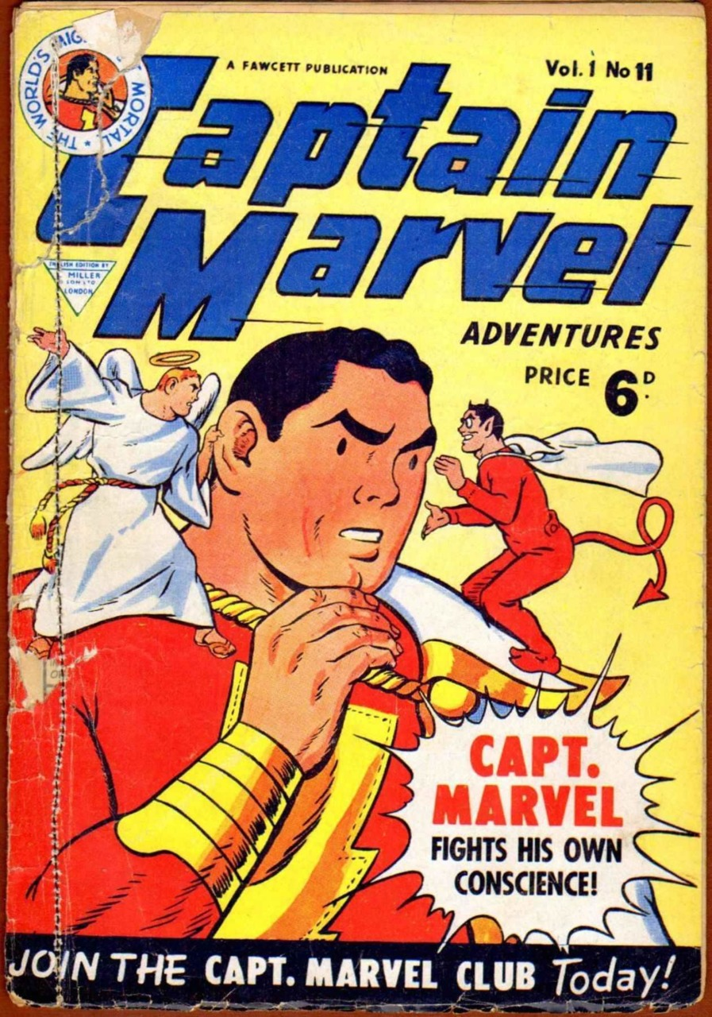
Otto Binder: His Final Years
Otto Binder's daughter Mary, on her way to school one morning, was killed when a car jumped the curb and sped into the driveway in front of her school.
As film producer and comics historian Michael Uslan, a family friend, recalled, "Otto never recovered. His wife never recovered. She had a breakdown, and Otto started drinking, and eventually he dropped dead of a heart attack. And the three of them were gone, like in a flash . . .“
Fun fact: Binder is referenced in the first episode of the 2015 television series Supergirl as the title character prevents a crippled jet from crashing into the "Otto Binder bridge.“
Notes:
Sources:
Wikipedia, https://en.wikipedia.org/wiki/Otto_Binder
Recollection of Michael Uslan in Smith, Zack (December 30, 2010). "An Oral History of Captain Marvel: The Lost Years, Part 3". Newsarama. Archived from the original on December 19, 2013.
Image source: https://comicvine.gamespot.com/captain-marvel-adventures-11/4000-780964/user-reviews/

Slide 9
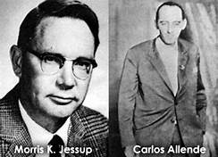
Morris K. Jessup: UFO Investigator (1900-1959)
Earned a Master’s degree in Astronomy, though he dropped his doctorate
work and worked most of his life as an auto parts salesman and photographer
Author, The Case for the UFO (1955), famous for the Allende letters, related to the Philadelphia Experiment.
UFO and the Bible (1956)
UFO Annual (1956)
The Expanding Case for the UFO (1957)
Jessup believed he was being spied upon (by Men in Black), his office to be ransacked, and he was confronted by Navy officials regarding his knowledge of the UFO subject.
April 20, 1959, Jessup was found dead in his car on a roadside in Dade County, Florida, a hose ran from the exhaust pipe to a rear window. His death was officially ruled a suicide.
Some believe the circumstances surrounding his death were suspicious and somehow related to Jessup’s knowledge of the Philadelphia Experiment and the Carlos Allende case (Moore and Bertltz, 1979). Reportedly, Jessup was excited about an upcoming meeting with a friend, author/explorer J. Manson Valentine (The Bermuda Triangle). Jessup never made the meeting. Many of Jessup’s files intended for his meeting with Valentine curiously went missing.
Notes:
Sources:
Moore, W.L. & Berlitz, C. (1979). The Philadelphia Experiment: Project Invisibiltiy. Fawcett Crest, NY.
Redfern, N. (2021), UFO Researcher Morris Jessup: Murdered for what he knew? Mysterious Universe. https://mysteriousuniverse.org/2021/01/ufo-researcher-morris-jessup-murdered-for-what-he-knew/

Slide 10
Additional source: Clark McClelland, Harry Cooper
Space! The Final Frontier: Secrets NASA Doesn’t Want You To Know
Available at Sharkhunters.com
Regarding J. Monson Valentine, friend of Morris Jessup, the authors claim Valentine discovered a huge underwater pyramid near the Bahamas and the Bimini Wall. Jessup is alleged to be one of the top scientists in the Philadelphia Experiment.
Notes:
YouTube: https://www.youtube.com/watch?v=LdM1fM3IAb8

Slide 11
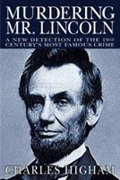
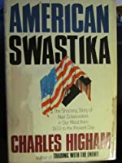
Author, celebrity biographer, Charles Higham (1931-2012)
While working on the biography of Nazi leader Rudolf Hess, Higham allegedly came across sensitive documents which were not to be publicly accessible for at least a century. The documents allegedly proved that Hess’s mysterious parachute landing into England was a peace mission from Hitler.
The morning after his manuscript was sent for publishing, Higham was found dead of an apparent coronary in his home in L.A. During his storied career, which included biographies on Errol Flynn, Howard Hughes, Queen Elizabeth, Katharine Hepburn, Orson Welles, Carey Grant, Marlon Brando and many others, Higham had undoubtedly uncovered tons of proverbial dirt on countless Beast System actors and minions. Higham also wrote the controversial American Swastika: The Shocking Story of nazi collaborators in our midst from 1933 to the Present Day.
I could find no publication on Amazon or anywhere else by Higham specifically on Hess.
Notes:
Sources:
Sources:
https://www.latimes.com/local/obituaries/la-me-charles-higham-20120504-story.html
Unpleasant Truth, 1941 Parachuting of Rudolf Hess in England
Wars and Lies, Sylvain Laforest
https://www.veteransnewsreport.com/2018/08/29/unpleasant-truth-1941-parachuting-of-rudolf-hess-in-england/
https://editionscharlou.com/the-books/wars-and-lies/
Hess and the Penguins, Dr. Joseph Farrell.
https://home.solari.com/book-review-hess-and-the-penguins-by-dr-joseph-p-farrell/

Slide 12
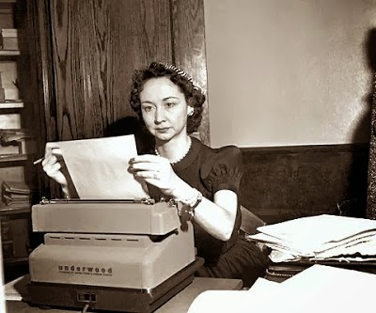
Dorothy Kilgallen
The most famous female syndicated journalist of her time (What’s My Line, CBS), privy to many secrets of the British elite.
Stationed in England in the mid Fifties, she wired a pair of sensitive dispatches, the first in February 1954, the second in 1955, which may have cost her life.
”We believe, on the basis of our inquiry thus far, that saucers were staffed by small men - probably under four feet tall. It's frightening, but there is no denying the flying saucers come from another planet.”
The source of the dispatch was rumored to be Lord Earl Mountbatten (Dorothykilgallen.com, 2013).
Kilgallen had also done extensive and controversial writing on the JFK assassination.
On November 8, 1965, she was found dead from an overdose of alcohol and barbiturates.
Notes:
Sources:’
https://www.dorothykilgallen.com/2013/10/the-death-of-dorothy-kilgallen.html
: https://www.bibliotecapleyades.net/sociopolitica/sociopol_scientistkilling03.htm

Slide 13
Frank Allyn Edwards: American writer, broadcaster and radio pioneer
A well-known UFO researcher and host of the Stranger Than Science radio show
Died of a sudden heart attack, June 24, 1967 (anniversary of the Kenneth Arnold UFO sightings)
Strangely, fellow UFO researcher Gray Barker claimed to have received anonymous threats during the NYC World UFO Conference, promising that Edwards would not see the end of the conference alive.
Notes:
Sources:
Moore, W.L. & Berlitz, C. (1979). The Philadelphia Experiment: Project Invisibiltiy. Fawcett Crest, NY.
Redfern, N. (2021), UFO Researcher Morris Jessup: Murdered for what he knew? Mysterious Universe. https://mysteriousuniverse.org/2021/01/ufo-researcher-morris-jessup-murdered-for-what-he-knew/
Swancer, B. (2020). UFO Researchers and Mysterious Deaths. Mysterious Universe. https://mysteriousuniverse.org/2020/06/ufo-researchers-and-mysterious-deaths/

Slide 14
Dr. James McDonald
Author: Twenty-Two Years of Inadequate UFO Investigations (1969)
Atmospheric Physicist at the University of Arizona
Before the U.S. Congress, 1968, stated:
"My own present opinion, based on two years of careful study, is that UFOs are probably extraterrestrial devices engaged in something that might very tentatively be termed 'surveillance’”.
In the process of trying to convince Congress to investigate the UFO question, suffered a gunshot wound to the head in the desert, 1971. McDonald was wheelchair-bound.
McDonald had previously criticized the Project Blue Book investigations as “completely superficial.”
Notes:
Source:
Swancer, B. (2020). UFO Researchers and Mysterious Deaths. Mysterious Universe. https://mysteriousuniverse.org/2020/06/ufo-researchers-and-mysterious-deaths/
Science in Default:
Twenty-Two Years of Inadequate UFO Investigations
American Association for the Advancement of Science, 134th Meeting
General Symposium, Unidentified Flying Objects
James E. McDonald, Professor of Atmospheric Sciences
The University of Arizona
Tucson, Arizona
December 27, 1969

Slide 15
Ivan T. Sanderson
Cryptozoologist and UFO afficionado
Died of an aggressive cancer, 1973.
Notes:
Source:
Swancer, B. (2020). UFO Researchers and Mysterious Deaths. Mysterious Universe. https://mysteriousuniverse.org/2020/06/ufo-researchers-and-mysterious-deaths/

Slide 16
Dr. Allen J. Hynek
Consultant/investigator for Project Blue Book.
Died of prostate and brain cancer, 1986.
Notes:
Source:
Swancer, B. (2020). UFO Researchers and Mysterious Deaths. Mysterious Universe. https://mysteriousuniverse.org/2020/06/ufo-researchers-and-mysterious-deaths/

Slide 17
Con Routine
Notes:
Source:
Swancer, B. (2020). UFO Researchers and Mysterious Deaths. Mysterious Universe. https://mysteriousuniverse.org/2020/06/ufo-researchers-and-mysterious-deaths/
http://www.metatech.org/ufo_research_magazine_evidence.html

Slide 18
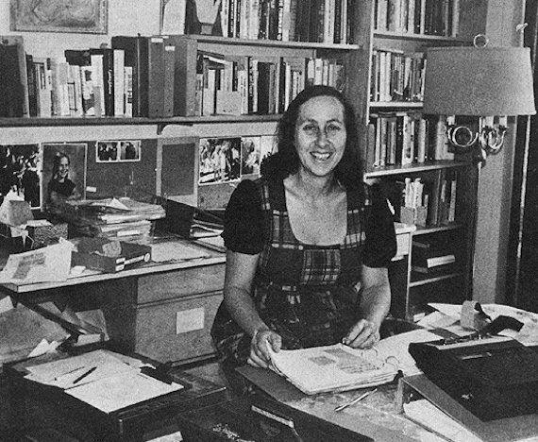
Mae Brussell
Radio talk show host, Conspiracy Dialogue.
Died of a fast-acting cancer, 1988.
Notes:
Source:
Swancer, B. (2020). UFO Researchers and Mysterious Deaths. Mysterious Universe. https://mysteriousuniverse.org/2020/06/ufo-researchers-and-mysterious-deaths/

Slide 19
--Fell to his death from the 16-story window of his Bethesda Naval Hospital room, May 22, 1949. Death officially ruled a suicide. By the way, Forrestal was a strict Catholic. --At odds with President Truman and Air Force Secretary Symington, suffered a catastrophic mental breakdown in 1948. Why? --Believed in a Communist infiltration of the U.S. government and that he was being shadowed by “Zionist” agents and the FBI. Men in Black? -- Was a key figure in the formation of the US government’s UFO policy. --Threatened to publish his private diary which clearly contained sensitive information
James Forrestal: Secretary of the Navy
1892-1949 “They’re after me . . .”
Source: Dolan, r. (2001). The Death of James Forrestal. UFO Magazine.

Slide 20
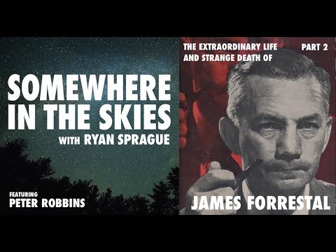
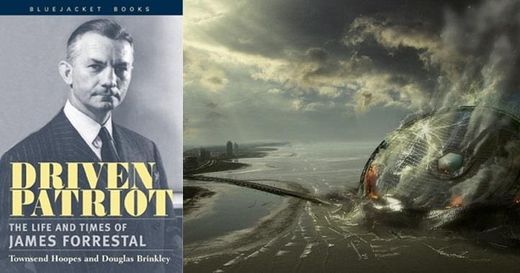
James Forrestal continued . . .
Notes:
The Extraordinary Life and Strange Death of James Forrestal - Part 2
https://www.youtube.com/watch?v=C-GR3HN8hHk

Slide 21
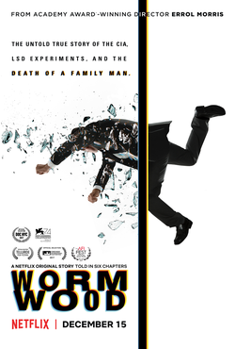
Dr. Frank Olson (1910-1953)
In 1953, fell from the 10th floor window of the Statler Hotel, NYC, victim of a bad LSD trip, courtesy of the CIA. Death ruled a suicide. (Dolan, 2001)
Sound familiar?
Worked for a secret government bio-warfare program, Camp Detrick, Maryland, and involved with MK-Ultra.
Olson’s last days were examined in the 2017 mini-series, Wormwood.
Olson was reportedly drugged during a semi-monthly retreat of the men closest to MK-Ultra in rural Deep Creek Lake, Maryland.
Journalist Seymour Hirsch claims the government had a secret process to identify and eliminate domestic dissidents, those who posed a threat (to national security).
The cases of Forrestal and Olson are so similar they are easily confused. Why are they so similar? Because it’s the same modus operandi the creeps use time after time. (Assuming there are creeps, of course.)
Directed by Errol Morris
Notes:
Additional Sources:
Kinzer, Stephen (2019). Poisoner in Chief: Sidney Gottlieb and the CIA Search for Mind Control. New York: Henry Holt.
Fort Detrick participants, alleged.
Olson, a scientist with the Special Operations Division of the United States Army Biological Warfare Laboratories at Fort Detrick, who was suspected of being a security risk.
Lt. Col. Vincent Ruwet, Olson's supervisor, the head of the Special Operations Division.
John L. Schwab, who had founded the division and in 1953 served as its lab chief^{[21]}
John Stubbs, one of the Fort Detrick personnel^{[21]}
Benjamin Wilson, a member of the Special Operations Division.
Herbert "Bert" Tanner, one of the Fort Detrick personnel^{[21]}
John C. Malinowski, a Detrick staffer who didn't drink alcohol and thus was not dosed.^{[22]}
Gerald Yonetz, a Special Operations Division scientist
CIA participantsSidney Gottlieb, a CIA chemist responsible for Project MKUltra.^{[23]}
Robert Lashbrook, Gottlieb's deputy, who dosed the liquor everyone was drinking along with Gottlieb.
A. Hughes, suspected to be CIA^{[21]}
Henry Bortner, of the CIA^{[21][24]}

Slide 22
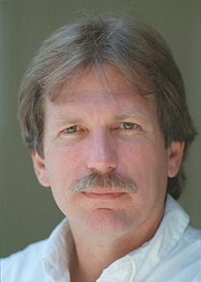
Gary Webb, Journalist (1955-2004)
Author, “The Dark Alliance” series, San Jose Mercury News, 1996
Published The Dark Alliance: The CIA, the contras and the crack cocaine explosion, 1998
Allegedly committed suicide, 2004, his body found with 2 gunshot wounds to the head
The 2014 film, Kill the Messenger, portrays Webb’s
life and investigations

Slide 23
Dave McGowen (1960-2015)
EMPLOYMENT
Writer and Contractor (owner of DC Construction from 1995 until death in 2015)
MEMORABLE PAST
Liquor store clerk and troubled teen — an excellent combination
Zinc smelter — manually mixed, poured, and skimmed molten zinc alloys … ahhh, the good old days!
Night custodian for Torrance Unified School District — ever wonder who got to clean those restrooms?
TRAUMATIC TRUE LIFE EXPERIENCES
Narrowly missed by stray copper-jacketed .45 slug of unknown origin
Shot at with several rounds in a drive-by shooting circa 1976
In 8th grade, had own mother for a substitute teacher, and she sent my best friends to the principal’s office (with apologies to Mom, who viewed this page and did not appreciate the attempt at humor).
Author:
Derailing Democracy (2000)
Understanding the F Word (2001)
Programmed to Kill (2004)
Weird Scenes Inside the Canyon (2014)
Why Everything You Think You Know about the Lincoln Assassination is Wrong (2014).
Notes:
Sources:
https://centerforaninformedamerica.com/books/
During a radio appearance in April, 2015 iMcGowen received a warning that he had better “watch out for cancer.” A week later he was diagnosed with cancer. (Crimes of Empire, 2015)
https://crimesofempire.com/2015/12/18/rip-dave-mcgowan/#:~:text=On%20November%2022nd%202015%2C%20American%20journalist%20and%20researcher,known%20for%20his%20work%20on%20the%20Moon%20landings.

Slide 24
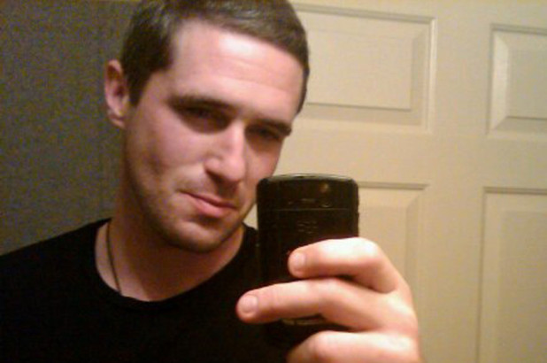
Max Spiers (1976-2016)
Paranormal investigator
“”Your boy’s in trouble. If anything happens to me, investigate” Max Spiers sent this text to his mother days before his death. Max Spiers, a British Ufologist and Conspiracy theorist, 39, from Canterbury, was found dead in Warsaw allegedly after vomiting black fluid.
(Buggedspace.com, 2020.)
Project Mannequin
One of the secret projects Spiers said he was a part of was “Project Mannequin” – a cloning program whose aim is to produce not only super soldiers but trained and unknowing assassins. This program operates in the United Kingdom but falls under the NSA. It overlaps with similar programs run by the United States agencies such as MK-ULTRA, and mind and behavior control (Lowth, 2017).
Notes:
Sources:
Max Spiers: The mysterious death of a conspiracy theorist (Part 1) - BBC Stories
https://www.youtube.com/watch?v=Heqpn8z4R0o
Marcus Lowth (2017) UFO Insight. https://www.ufoinsight.com/aliens/agendas/project-mannequin-max-spiers

Slide 25
Granger Taylor: Disappeared
(1948-????)
A true genius, mechanical prodigy and auto-didact, born in Vancouver, B.C.
As a teenager, Taylor restored dead vehicles from cars to steam engines to a vintage Kitty Hawk military plane he sold for a reported $20,000.
Taylor claimed to have come into telepathic contact with extra-terrestrial beings and became obsessed with building a replica of a spaceship.
On the night of November 29, 1980, amidst a violent storm, Taylor walked out of his parents’ home, never to be seen again.
Leaving behind all his possessions including a substantial amount of money, Granger had left behind a strange note for his parents.
Notes:
Source:
The Paranormal Scholar. 2021. Granger Taylor: The Mysterious Disappearance of a Man Lost in Space.
https://www.paranormalscholar.com/granger-taylor-the-mysterious-disappearance-of-a-canadian-man-lost-in-space/

Slide 26
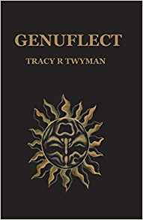
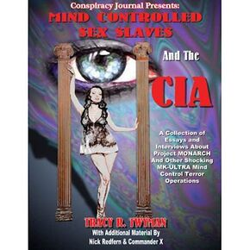
Tracy Twyman (1978-2019)
Author and conspiracy researcher
Dagobert’s Revenge, underground esoteric magazine (1996-2003)
Solomon’s Treasure: The magic and mystery of America’s Money (2005)
Mind-controlled sex slaves and the CIA (2008)
The Merovingian Mythos and the Mystery of Rennes-le-chateau (2011) **(Why so pricy on Amazon?)
Money grows on the Tree of Knowledge (2011)
Clock Shavings (2014) (Again, why so high $$$ on Amazon?)
Baphomet: the Temple Mystery Unveiled (2015)
Genuflect (2017)
Tracy’s death was by hanging near a Williams, AZ campground. A posthumously released video reported details of her computer being hacked and previous death threats against her.
Notes:
References
https://wikispooks.com/wiki/Tracy_Twyman
↑ https://www.youtube.com/channel/UCrK54gklfCVXZ7iky95pPNg
↑ https://www.thehighersidechats.com/a-statement-from-greg-carlwood-regarding-the-tragic-loss-of-tracy-twyman/
↑ https://networthpost.org/net-worth/tracy-twyman-net-worth/
↑ http://archive.fo/QaDeP
↑ http://archive.fo/7OVzb
↑ https://www.amazon.com/Genuflect-Tracy-R-Twyman/dp/1521491445
↑ http://archive.fo/NoUdi
↑ http://www.unwelcomeguests.net/750
↑ https://burners.me/2019/07/10/another-pedogate-researcher-suddenly-dies-rip-tracy-twyman/
↑ https://burners.me/2019/07/19/tracy-twyman-update/
↑ https://www.youtube.com/watch?v=EMS0uuQVbBs
↑ http://archive.fo/FYuBW
Posthumously released video
Tracy Twyman made a 27 minute video which on 24 May 2019 she reportedly gave to just 2 friends for safekeeping, one of whom posted it after her death.^{[8]} It included details of threats against her, and her suspicions that her computer was hacked, connections between her own case and that of Isaac Kappy and about a "creepy" Arizona campground that was suddenly closed later.^{[9][10][11]}
https://youtu.be/EMS0uuQVbBs
https://rosamondpress.com/2020/02/17/tracy-twyman-is-dead/
Friday, August 9, 2019
Tracy Twyman, Pizzagate researcher, murdered
Researcher Tracy Twyman sent me this video on May 24, 2019. She asked me not to share it publicly at the time because she was in fear for her life. She had been in communication with Isaac Kappy about threats she had received related to a campground near Williams, Arizona.
Kappy died very close to the campground. Today I learned that Tracy passed away at the age of 41, after quitting social media and YouTube.
I do not know the circumstances of her death, but if someone says “I’m afraid for my life” and then suddenly dies, this warrants further investigation. The timing of this as Jeffrey Epstein is arrested is highly suspicious.
I note the mysterious disappearance of Robert the Deplorable, and also the sudden death of #Pizzagate researcher Jenny Moore in August 2018. I’ll explain the content of the video a bit. Tracy was a guest on The Higherside Chats podcast a few times. This video was released on the 10th, but she made it two months ago and gave it to a friend. She is now dead, and her friend posted this dead-man switch video she made.
This is the message she wanted to get out, but didn’t post because she feared for her life. She apparently discovered on youtube a vast trove of pedo videos where they were selling the videos or perhaps even the children themselves via the videos. She gathered binders of evidence, and took it to the FBI to report it. She was completely boxed out and they refused to take her report basically, even in the initial contact. She had located a specific school in England near Yorkshire where it appeared many of the children there were being prostituted out via Youtube. Some of the videos were also specifically designed as threats to the children. After reporting it to the FBI, her internet connection starting frequently malfunctioning, and her phone was acting very strangely. Then she was receiving many death threats with fears seemingly personally tailored to her, they apparently knew everything about her. Kyle is a friend of her and the host of the higherside chats, who had a mental breakdown after beginning to investigate this information.
http://www.project.nsearch.com/profiles/blogs/pedogate-deadman-switch-tripped-after-researcher-died-fbi-ignored

Slide 27
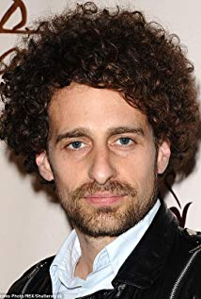
Isaac Kappy (1977-2019)
Actor
Made varoius accusations about the prevalence of pedophilia in Hollywood, including against people he describes as former friends. These included Seth and Claire Green, whom he claimed had a hidden room in their mansion “where we keep the children”. He also stated that Steven Spielberg as a pedophile.
The Arizona Daily Sun reported that Kappy jumped to his death from a bridge and was struck by a pick-up truck on Interstate 40 near Bellemont, AZ (March, 2019).
His last Instagram post stated, In the event of his death, certain things would be released to the police on July 4, 2019. Jeffrey Epstein was ultimately arrested and charged on July 6, 2019."
Fun fact: Kappy was contacted by Tracy Twyman, a VIPaedophile researcher who herself was found dead in unclear circumstances two months after Kappy died.
Notes:
Sources: https://wikispooks.com/wiki/Isaac_Kappy
https://magamedia.org/2019/07/14/isaac-kappys-deadman-switch-epsteins-island-of-sex-and-blackmail-is-sinking/
https://burners.me/2019/05/14/the-mysterious-sudden-death-of-isaac-kappy/
https://celebrityinsider.org/was-isaac-kappy-murdered-an-open-secret-says-no-284327/

Slide 28
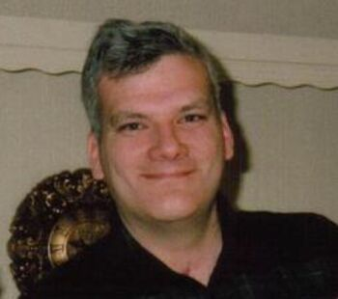
Philip Schneider (1947-1996)
“The Battle of Dulce” N.M.) 1979
A self-taught geologist who dabbled in explosives
Claimed to have worked in 13 separate secret underground facilities
Told of surviving the Dulce New Mexico battle between facility security and telepathic Gray aliens. (According to conspiracy icon John Leer, it wasn’t much of a battle. An entire room of scientists and others were wiped out telekinetically by a pissed-off alien.
Schneider was found strangled by a catheter in his hospital bed. Rather incredibly, his death was ruled a suicide (Philip, 2018).
Notes:
Image source: Captain Mark Richards . . . https://projectcamelotportal.com/2019/01/04/recommended-captain-mark-richards-battles-of-vesta-and-dulce/

Slide 29
Ron Rummel, UFO investigator
Former U.S. Air Force Intelligence Officer, and friend of Phil Schneider
Publisher of Alien Digest
Perished due to an apparent self-inflicted gunshot, August 6, 1993.
Strange allegations: The gun had no blood or fingerprints on it. The suicide note was written by a left-handed person. Rummel was right-handed. Reportedly the aroma of sodium pentothal was detected at the crime scene (Philip, 2018).

Slide 30
Jim Keith, conspiracy researcher and writer (1949-1999)
Author
Black Helicopters over America
The Octopus
Mind Control/World Control
Saucers of the Illuminati
(written under the pseudonym, Jay Katz)
--The Octopus co-written with Kenn Thomas
After breaking his leg falling off a stage at Burning Man, Keith died of a blood clot in the ICU at the Washoe hospital shortly after surgery.
Reportedly, just before his death he had told several people “I have this feeling that if they put me under I’m not coming back.” (Philips, 2018).
Oddly, the coroner’s report listed “blunt force trauma” as the cause of death.
Notes:
Additional publications:
Secret and Suppressed: Banned Ideas and Hidden History. Venice, Calif.: Feral House (1993). ISBN 0922915148.
Sources:
http://www.adventuresunlimitedpress.com/search.php?pg=1&stext=Jim+Keith
Philip, Olov. (2018). Paranoia The Conspiracy Reader. (12/4/2018) Publish and Perish: The Mysterious Body Count of UFO and the Darker Side of Conspiracy Research.
http://www.paranoiamagazine.com/2018/12/publish-and-perish-the-mysterious-body-count-of-ufology-and-the-darker-side-of-conspiracy-research/

Slide 31
The Octopus
This book details conspiracy theories around the death of reporter Danny Casolaro and NSA employee Alan Standorf.
The book is based on the notes of Danny Casolaro, who reportedly killed himself, although Keith and Thomas examine the case for foul play in their book.
Notes:
Thomas, Kenn; Keith, Jim (2004). The Octopus: Secret Government and the Death of Danny Casolaro. Feral House. p. 56. ISBN 9780922915910. Alan Standorf.
Image source: https://www.redbubble.com/i/t-shirt/Cyberpunk-Geometry-Anime-Octopus-Purple-by-glitchedingrey/44128007.FB110

Slide 32
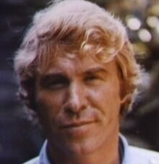
Danny Casolaro, freelance reporter
At the age of 44, Danny was found deceased in a motel bathtub near Martinsburg, West Virginia. Both his wrists had been slashed and a suicide note lay near the body. Several of his fingertips were missing.
Hundreds of notes and documents relating to an investigation he had been working on strangely disappeared.
Reportedly days before his death, Danny told several people that he was close to a break in a big case involving Justice Department corruption, a D.C. company called Inslaw, and (wait for it) the CIA, FBI, NSA and NSC. The case allegedly surrounded a surveillance software program called PROMIS which promised revolutionary new information management for law enforcement agencies (Thomas and Keith, 1996).
Prior to his death, Danny reported he had received numerous death threats. (Thomas and Keith, 1996). He was planning on visiting a sensitive facility connected to CIA clandestine operations and “The Octopus.” (Flatley, 2021)
,
Notes:
Sources:
Thomas, K and Keith, J. (1996) The Secret Government and the Death of Denny Casolero.
The Last Circle: Danny Casolaro's Investigation into the Octopus and the PROMIS Software Scandal Paperback – Illustrated, September 26, 2010
The Parapolitics of Software Piracy
Danny Casolaro and the Surveillance State (Parts 1 and 2)
Joseph L. Flatley
2021
https://lennyflatley.substack.com/p/danny-casolaro-and-the-surveillance-0aa
Fandom: Unsolved Mysteries
https://un
solvedmysteries.fandom.com/wiki/Danny_Casolaro

Slide 33
Ron Bonds, writer/publisher
In April, 2001, Bonds, who had published much of Jim Keith’s work, would die mysteriously from internal bleeding reportedly due to contaminated beef after having dinner in an Atlanta Mexican restaurant.
No other individuals who ate at the restaurant that day reported any problems.
Bonds was the first person to die from food poisoning in Fulton County in several decades (Philips, 2018).

Slide 34
Ann Livingston, author and UFO investigator
Accountant and part-time investigator for Mufon
Author of Electronic Harassment and Alien Abductions
Died of an aggressive form of ovarian cancer, 1994 (Philips, 2018).
Rather spookily, years earlier she claimed to have been harassed by ghoulish faceless, pale, and sinister Men in Black (Swancer, 2020).

Slide 35
Ron Johnson, Mufon Deputy Director of Investigations
Formerly worked at Hal Puthoff’s Austin Think Tank
Perished in 1994 after giving a lecture at the society of scientific exploration in Austin, Texas. Died of an apparent stroke, although death was ruled inconclusive. (Philip, 2018).

Slide 36
Karla Turner, UFO author
Author, Masquerade of Angels
Author, Taken
Author, Into the Fringe
Died of cancer, 1996
Notes:
Source:
Swancer, B. (2020). UFO Researchers and Mysterious Deaths. Mysterious Universe. https://mysteriousuniverse.org/2020/06/ufo-researchers-and-mysterious-deaths/

Slide 37
Paul Vigay, UFO investigator
In 2009, Vigay was found dead in the sea off the coast of Portsmouth.
Vigay had left a strange series of messages on his phone prior to his death.
Cause of death was undetermined.
Notes:
Source:
Swancer, B. (2020). UFO Researchers and Mysterious Deaths. Mysterious Universe. https://mysteriousuniverse.org/2020/06/ufo-researchers-and-mysterious-deaths/

Slide 38
Brian Lynch, young psychic and contactee
Died in 1985, purportedly of a drug overdose.
According to Lynch's sister, Geraldine, Brian was approached approximately a year before his death by an intelligence operative working for an Austin, Texas, PSI-tech company. Geraldine said they told Brian they were experimenting on psychic warfare techniques.
After his death, a note in his personal effects was found with the words "Five million from Pentagon for Project Scanate."
Notes:
Source:
Swancer, B. (2020). UFO Researchers and Mysterious Deaths. Mysterious Universe. https://mysteriousuniverse.org/2020/06/ufo-researchers-and-mysterious-deaths/

Slide 39
Captain Don Elkin, airline pilot
In the '80s Eastern Airlines pilot Capt. Don Elkin committed suicide.
He had been investigating the UFO coverup for over 10 years and, at the time,
was deep into the study of the Ra material with Maria Rucker.
There are reports of negative psychological interferences having developed
during this latter investigation.
Notes:
Source:
Swancer, B. (2020). UFO Researchers and Mysterious Deaths. Mysterious Universe. https://mysteriousuniverse.org/2020/06/ufo-researchers-and-mysterious-deaths/
https://www.bibliotecapleyades.net/sociopolitica/sociopol_scientistkilling03.htm

Slide 40
Strange deaths on June 24, summer solstice and Feast Day of St. John the Baptist (Keel, J, 1967, Coleman, L., 1975)
Frank Scully, author
Arthur Bryant, UFO contactee
Richard Church, UFO Contactee
Willy Ley, Rocket Scientist
Robert Charroux, French Fortean writer
Jackie Gleason, Actor and UFO Buff, a close friend of Richard Nixon
Notes:
Additional sources:
Suicide Clusters (Boston: Faber & Faber, 1987) ISBN 0571129838
The Copycat Effect: How the Media and Popular Culture Trigger the Mayhem in Tomorrow's Headlines (New York: Simon and Schuster, 2004) ISBN 0743482239
The Night That JACKIE GLEASON Completely Lost It - NIXON SHOCKER!
https://www.youtube.com/watch?v=Voi20F8Gz70

Slide 41
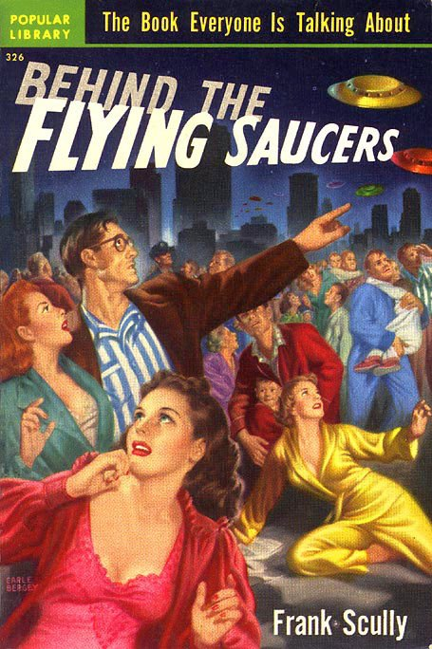
Frank Scully (1892-1964)
In October and November 1949, Scully published two columns in Variety, claiming that dead extraterrestrial beings were recovered from a flying saucer crash, based on what he said was reported to him by a scientist involved. His 1950 book Behind the Flying Saucers expanded on the theme, adding that there had been two such incidents in Arizona and one in New Mexico, a 1948 incident that involved a saucer that was nearly 100 feet (30 m) in diameter.
Awarded Knight of the Pontifical Order of St. Gregory the Great, 1956.
A marginal figure in UFO history, he didn’t die suspiciously or early, as far as we know.
Notes:
Sources:
Scully, Frank. Frank Scully papers, 1927–1985. Laramie, Wyoming: American Heritage Center, University of Wyoming. OCLC 34073391.
Wikipedia.
https://en.wikipedia.org/wiki/Frank_Scully

Slide 42
Bizarre Deaths of Scientists
Note: Over 20 scientists working on a pilot program for America’s Star Wars Defense Initiative have met bizarre, often violent deaths. How curious is that?
Roger Hill, a designer at Marconi Defense Systems, allegedly commits suicide with a shotgun, March 1985.
Jonathan Walsh, a digital communications expert employed by GEC, Marconi's parent firm, falls from his hotel room, November 1985, after expressing fear for his life.
Ashad Sharif, another Marconi scientist, reportedly tied a rope around his neck, and then to a tree, in October 1986, got behind the wheel of his car and stepped on the gas with predictable results.
In March of 1988, Trevor Knight, also associated with Marconi, died of carbon monoxide poisoning in his car.
Peter Ferry, marketing director of the firm, was found shocked to death with electrical leads in his mouth (August 1988).
Also during the same month of the same year, Alistair Beckham was found shocked to death with electric leads attached to his body and his mouth stuffed with a handkerchief. He was an engineer with the allied firm of Plessey Defense Systems.
And, finally, but by no means the sole remaining death in this unique cluster, Andrew Hall was found dead in September of 1988 of carbon monoxide poisoning.
Notes:
Source:
https://www.bibliotecapleyades.net/sociopolitica/sociopol_scientistkilling03.htm

Slide 43
Bob Garrett and the 3 Miles In footage (Predator being)
Hunting guide and bigfoot researcher Bob Garrett came across an abandoned campsite that looked more like a crime scene. Garrett caught on video images of what looked like an invisible entity very similar to the predator movie creature.
After going public with his evidence and his own personal experiences investigating the sasquatch phenomenon, his evidence was confiscated by the U.S. Government, allegedly the department of homeland security. Garrett has essentially disappeared from the bigfoot research community.
Notes:
Source:
The Government Just Shutdown a Bigfoot Researcher.
page: 1
https://www.abovetopsecret.com/forum/thread1051486/pg1
YouTube
https://www.youtube.com/watch?v=GA5pplK-Hfo
Reality Check-Jay Weidner and Jack Cary
Monsters and Men
https://www.youtube.com/watch?v=tpXBc1JmwfE

Slide 44
References
Binder, O. (1971). Liquidation of the UFO Investigators.
Bugged Space. (2020). The conspiracy theory behind death of UFO conspiracy theorist Max Spiers.
https://www.buggedspace.com/conspiracy-murder-of-max-spiers/
Center for an Informed America. https://centerforaninformedamerica.com/books/
Coleman, J. Conspirators’ Hierarchy: The Story of the committee of 300.
https://www.cia.gov/library/abbottabad-compound/4A/4A92FD2FB4DAE3F773DB0B7742CF0F65_Coleman.-.CONSPIRATORS.HIERARCHY.-.THE.STORY.OF.THE.COMMITTEE.OF.300.R.pdf
Coleman, L & Clark, J. (1975). The Unidentified: Notes toward solving the UFO mystery. Warner paperback
Dolan, R. (2001). The Death of James Forrestal. UFO Magazine.
Fenster, M. (2008). Conspiracy Theories: Secrecy and Power in American Culture. U. Of Minnesota Press.
Keel, J. (1967) “The Answer”. Johnkeel.com

Slide 45
References continued
.
McClelland, C, Cooper, H (2020). Space! The Final Frontier . . .
Moore, W.L. & Berlitz, C. (1979). The Philadelphia Experiment: Project Invisibiltiy. Fawcett Crest, NY.
Philip, Olov. (2018). Paranoia The Conspiracy Reader. (12/4/2018) Publish and Perish: The Mysterious Body Count of UFO and the Darker Side of Conspiracy Research.
http://www.paranoiamagazine.com/2018/12/publish-and-perish-the-mysterious-body-count-of-ufology-and-the-darker-side-of-conspiracy-research/
Redfern, N. (2021). UFO Researcher Morris Jessup: Murdered for What He Knew? Mysterious Universe.
https://mysteriousuniverse.org/2021/01/ufo-researcher-morris-jessup-murdered-for-what-he-knew/
Swancer, B. (2020). UFO Researchers and Mysterious Deaths. Mysterious Universe. https://mysteriousuniverse.org/2020/06/ufo-researchers-and-mysterious-deaths/
The Mad Truther. (2017). 5 Conspiracy Theorists & Researchers Who Mysteriously Disappeared or Were Seemingly Silenced
https://themadtruther.com/2017/07/29/5-conspiracy-theorists-researchers-who-mysteriously-disappeared-or-were-seemingly-silenced/
Thomas, K and Keith, J. (1996) The Octopus and the Death of Danny Casolaro. Feral House

