Slide 1
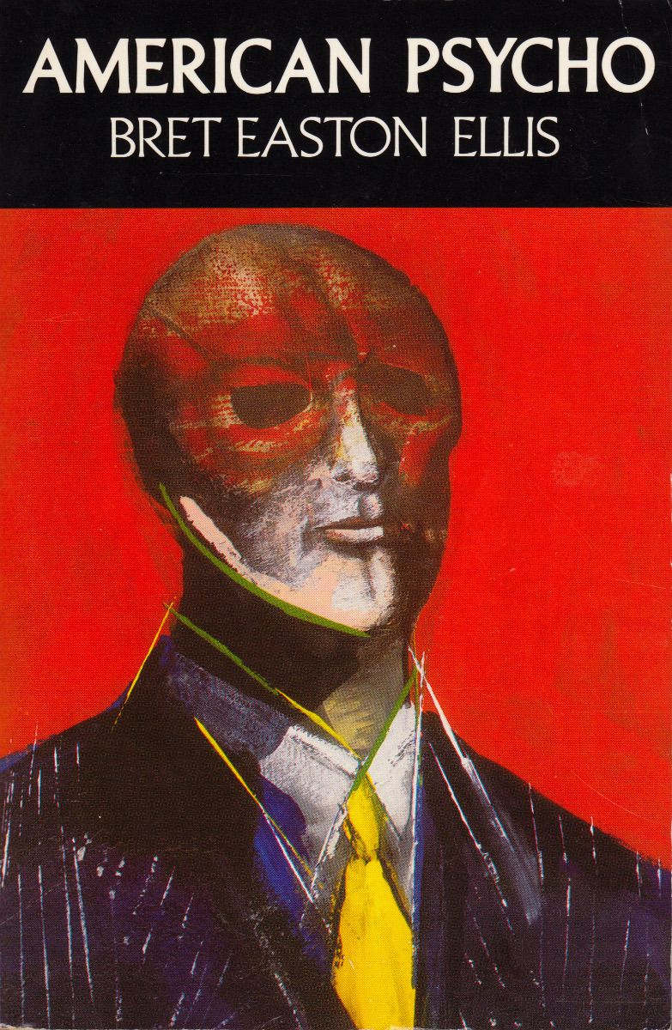
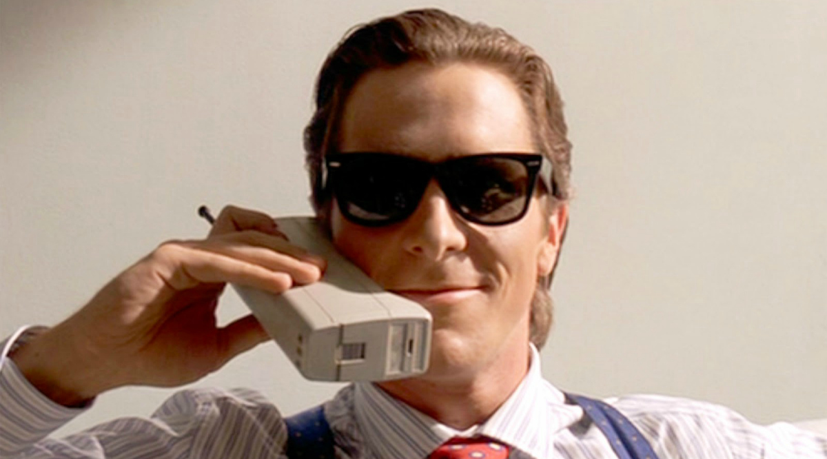
Clinical Assessment & Case Conceptualization:
Patrick Bateman from American Psycho (2000)
Michael V. Farnum CCMH/548 11/22/21
Picador Publishing
Notes:
Christian Bale Image source: Edward R. Pressman Productions
Muse Productions. American Psycho (2000)
American Psycho novel image source: Picador Publishing
Choose a character from a movie, television show, or fictional story with a possible personality disorder. You may use any of the characters listed on the Personality Disorders: Character Cases list, or use a different one of your choosing, with instructor approval.
Develop a DSM-5 diagnosis for the character based on your assessment of the presenting symptoms and behaviors.
Present your assessment and diagnosis of your character in a 10- to 15-slide Microsoft® PowerPoint® presentation.
Support the diagnosis with excerpts from the movie, show, or story. These could be clips embedded into the presentation or quotes with descriptions of the behaviors.
Include any assessment tools you might use for diagnosis or rule-outs of differential diagnosis.
Include any specifiers with your diagnosis.
Write a case conceptualization for your character based on a theoretical perspective.

Slide 2
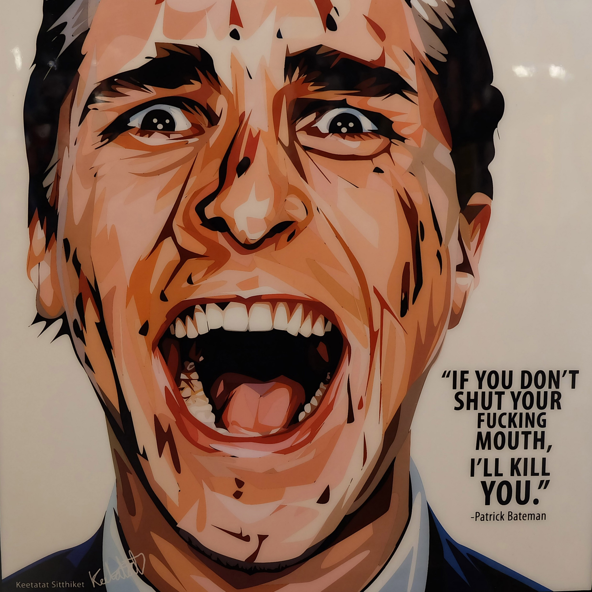
Meet Patrick Bateman
Personal Profile
Harvard Business School graduate. High-level Wall Street investment banker at the firm of
Pierce & Pierce
Official job title: Executive VP, Mergers & Acquisitions (aka Murders & Executions)
Idolizes Donald Trump, singer Whitney Houston, pop bands Huey Lewis & The News and Genesis
Enjoys working out, top-shelf men’s care products, designer clothes and furniture, high-tech gadgets, video horror, pornography, date rape, snuff filming & chainsaws
Hobbies: Analyzing pop music & culture; insulting people; violently abusing sex workers; rape/torture & murder fantasies; (possibly) murdering strangers, co-workers, prostitutes & police
American Psycho (2000)
Image source: https://www.infamousinspiration.com/product/american-psycho-pop-art-poster/
Notes:
For those who have never seen the 2000 psychological horror film, American Psycho, starring Christian Bale, based on the 1991 novel by Brett Easton Ellis, it is all about Patrick Bateman, a wealthy sociopath who darkly inhabits the uber-superficial high society of 1980s Manhattan (Harron, 2000). Patrick Bateman is a vane, highly narcissistic, self-obsessed and solipsistic high-level Wall Street investment banker, the prototypical NYC Yuppie on steroids, metaphorically speaking. But perhaps literally (although this is pure speculation). Bateman is proudly obsessed with his compulsive daily routine of self-beautification and top-shelf product application, his rigorous exercise regimen, his high-end designer clothes, furniture, high-tech electronic devices and other postmodern accouterments, along with impressing his gorgeous socialite fiancée (Reese Witherspoon) and his shallow circle of Yuppie peers, most of whom he secretly despises. Interestingly, he idolizes New York real estate mogul, Donald Trump (Ellis, 1991).
Bateman enjoys watching video horror (Texas Chain Saw Massacre) compulsively as he works out with an Uber-human vigor; frequently discusses serial killers in casual conversation; and openly admits to killing people, which his vapid friends take as an ongoing joke from wacky Patrick. As the insightful and often graphic narrative unfolds, it becomes soon apparent that Patrick is an unabashed sociopath, yet those around him, including his almost-equally self-absorbed fiancée, are ignorant of and oblivious to the fact.

Slide 3
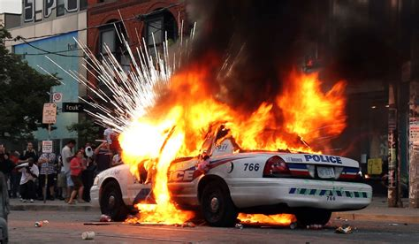
https://www.flickr.com/photos/coolvisual/4748485142
Significant Events
Real or fantasy?
Cruelly mocks and stabs to death a homeless man and his dog in a dark alley (YouTube link: https://www.youtube.com/watch?v=NY3yzLA-g24)
Lures a rival stockbroker to his apartment and murders him with an ax.
Drugs, rapes and murders a sex partner, then kills another, dropping a chainsaw on her as she flees
Kills police officers and blows up their police car?
Confesses to his attorney to murdering between 20-40 people
Notes:
Amidst yet another mundane business meeting, Bateman becomes quietly enraged by what he perceives to be the finer quality of the handsome business card presented by his rival co-worker, Paul (Jared Leto). Afterwards, to vent his frustrations, Bateman, after mockingly insulting a homeless man, stabs him and his dog to death in a dark, steamy alley. (Or imagines doing so?) At a Christmas party, Paul further agitates Bateman by mistaking him for another co-worker as Bateman’s furious envy is further fueled by Paul’s maddening ease at securing a coveted reservation at the exclusive restaurant Patrick is unable to get into. Bateman shortly extracts his revenge, getting Paul drunk and luring him back to Bateman’s apartment.
In perhaps the most pivotal scene in the film, carelessly grooving to the sounds of Huey Lewis’s “Hip To Be Square,” which he greatly admires, Patrick proceeds to murder Paul with an ax, clearly an act of unbridled premeditation in which the almost-vampiric Bateman has drawn a great, sadistic satisfaction. Rarely one to leave a mess, the obsessive-compulsive Patrick disposes of the body in the basement furnace of his apartment building. He then breaks into his victim’s apartment and promptly leaves a phony message on the man’s answering machine, informing his callers that Paul has taken an extensive business trip to London.
Later on, Patrick is once again driven to a murderous rage by the presentation of another co-worker’s more attractive business card. Patrick attempts to strangle the man in a restaurant bathroom but when his next would-be victim mistakes the attack for a homosexual come-on, Patrick flees in a panic, and later murders a model. After a pair of suspenseful meetings with a detective (Willem Dafoe) regarding Paul Allen’s disappearance, the detective reveals he received a report that Allen was actually spotted in London. Although his later proves to be false information, even better, the detective informs Patrick he has an alibi, a dinner party with his high society friends. This revelation temporarily takes him off the hook but only serves to confuse Patrick even further. During a rendezvous with one of his regular prostitutes, Christie, and another sex pal Elizabeth, in Paul Allen’s apartment, Patrick drugs, rapes and murders Elizabeth before chasing Christie, who ends up discovering a stash of female corpses. In his bloody, naked pursuit of Christie, Patrick drops a chainsaw on her as she flees down a staircase
The mayhem in Bateman’s life continues to escalate, becoming more farcical and ultra-violent. Patrick sees a cat while using an ATM, and imagines it instructing him to feed it a cat. As he attempts to shoot the cat, he is confronted by a woman whom he shoots before killing several cops pursuing him and blowing up their police car. He stumbles into a random office, killing a security guard and janitor to cover his tracks and ends up hiding under his desk evading (imaginary?) police helicopters. And around this point in the narrative, it appears that these bizarre events must be a complex of wild murder fantasies and/or homicidal hallucinations as the line between fantasy and reality is blurred beyond recognition for both Patrick and the movie viewer.

Slide 4
Bateman’s Observable Symptoms (most significant)
Positive symptoms of disorganized thinking and behavior; delusions of grandeur/persecution; and visual hallucinations (Criteria A for Schizophrenia)
Intermittent mania and depression (not pervasive)
Pervasive social/interpersonal deficits; cognitive/perceptual distortions; eccentricities of behavior (Schizotypal Personality)
Partial criteria met for Narcissistic Personality
Blatant disregard for and violation of the rights of others w/ deceitfulness, manipulation, hostility, aggression, homicidal tendencies (Anti-social Personality)
Recurrent, impulsive urges to watch pornography and video horror/engage in snuff filming (Addictive Personality)
Essential considerations: Can Bateman (usually) discern between his own distorted
cognition and reality? (Schizotypal) Evidence of conduct disorder in adolescence? (Antisocial Personality)
Notes:
When dealing with a fictional character one may have to rely on certain presumptions. In the case of Patrick Bateman, it is safe to presume that the majority of his myriad symptoms have been present for at least six months, but probably a year or even much longer. A significant question to consider is whether Patrick suffers from hallucinations, which he most likely does, all things considered. But if so, which of his experiences are real and which are only imagined? Here, we can only speculate.

Slide 5
Assessment Tools 1:
Schizotypal Personality: Schizotypy Personality Scale
(Claridge, Gordon, & Brooks, 1984).
Sample questions:
Does if often happen that almost every thought immediately and automatically suggests an enormous number of ideas?
Have you ever felt when you looked in a mirror that your face seemed different?
Do things sometimes feel as if they were not real?
Do you feel that you cannot get ‘close’ to other people?
Are you easily distracted from work by daydreams?
Do you ever have a sense of vague danger or sudden dread for reasons that you do not understand?
The Schizotypal Personality Questionnaire-Brief Revised(SPQ-BR) (Cohen, Matthews, Najolia and Brown, 2010)
Enables an exploratory assessment to screen individuals at risk for developing schizophrenia spectrum disorders.
(Cohen et al, 2014).
Notes:
“The Schizotypal Personality Questionnaire-Brief (SPQ-B) was developed with the aim of examining variations in healthy trait schizotypy, as well as latent vulnerability to psychotic-spectrum disorders” (Fonseca-Pedrero E, et al, 2018, p 182).
The Schizotypy Personality Scale is a subscale of the Schizotypal Questionnaire developed by Claridge and Brooks (1984). This scale measures the presence of schizotypal traits including psychotic episodes, irrational beliefs, cognitive disorganization, anxiety, reality distortion, blunted emotions, hostility, and asocial behavior.

Slide 6
Assessment Tools 2:
SCID-II: The Structured Clinical Interview for DSM-IV AXIS II personality disorders
Currently the gold standard for diagnosing any of the 10 personality disorders listed in DSM (Pomeroy, 2015).
119 items useful as a self-report screening tool
Diagnoses made by either the presence or absence of symptoms.
MMPI: The Minnesota Multiphasic Personality Inventory
NEO-PI-R: Measuring Neuroticism, Extroversion, Openness, Agreeableness, and Conscientiousness
Notes:
Accessible to professional clinicians, a wide variety of psychological assessment tools are utilized to assess a client’s personality, present disorders, social skills, cognitive abilities, emotions, behavioral responses, or interests and can be administered either individually or to groups These assessments include the SCID-II or Structured Clinical Interview for DSM-IV Axis II personality disorders; the MMPI or Minnesota Multiphasic Personality Inventory and the NEO-PI-R which is a concise measure of the five major domains of personality – Neuroticism, Extroversion, Openness, Agreeableness, and Conscientiousness (Pomeroy, 2015).

Slide 7
Assessment Tools 3:
Assessing Psychosis
Clinician-rated Dimensions of Psychosis Symptom Severity
8-item measure for clinical assessment of severity of symptoms within past 7 days.
Items measured on a 5-point scale with symptom-specific definitions of each rating level.
This assessment is an emerging measure for use in research and evaluation as potentially useful tools to enhance clinical decision-making. Not the sole basis for making a clinical diagnosis. (APA, 2013).
Notes:
Psychotic conditions present a wide range of cognitive impairments. The DSM-5 offers emerging measures for use in research and evaluation. As the DSM-5, Section 3 describes: “The Clinician-Rated Dimensions of Psychosis Symptom Severity provides scales for the dimensional assessment of the primary symptoms of psychosis, including hallucinations, delusions, disorganized speech, abnormal psychomotor behavior, and negative symptoms. A scale for the dimensional assessment of cognitive impairment is also included” (APA, 2013).

Slide 8
The Diagnoses
Client: Patrick Bateman
Primary Diagnosis: Schizotypal Personality Disorder, moderate impairment in functioning
Typical features of schizotypal personality disorder are impairments in the capacity for social and close relationships, and eccentricities in cognition, perception, and behavior that are associated with distorted self-image and incoherent personal goals and accompanied by suspiciousness and restricted emotional expression (APA, 2013).
Secondary Diagnosis: Unspecified Schizophrenic Spectrum and other Psychotic Disorders. Appropriate for diagnosis in emergency management situations where little personal history is known.
(Addendum):
Suspected Diagnosis: Anti-social Personality Disorder with psychopathic features, moderate to high functioning (technically not applicable due to limited childhood/adolescent history of subject).
Notes:
Presuming that Bateman does experience visual hallucinations, he does fit Criteria A for schizophrenia, in addition displaying the positive symptoms of disorganized thinking and behavior, as well as delusions of grandeur and persecution (American Psychological Association, 2013). While Bateman does experience mild anxiety and a significant degree of existential distress, mainly in the form of inner angst, dissatisfaction and ennui, for the most part he is essentially functional within his overly vapid and materialistic world, thus failing to meet Criterion B. (At least relatively functional, until things go quite bad, whether in his own mind or in so-called reality, at least temporarily.)
The normally mild-mannered Bateman likewise displays intermittent symptoms of both mania and depression yet it seems unlikely he presents with pervasive depressed mood despite the presence of intermittent diminished interest or pleasure, thus eliminating schizoaffective disorder. According to DSM-V, schizoaffective requires that a major depressive or manic episode occur concurrently with the active-phase symptoms and mood symptoms must be present for a majority of the total duration of the active periods (APA, 2013). Furthermore, delusions and hallucinations must occur exclusively during a major depressive or manic episode for a diagnosis of bipolar disorder with psychotic episodes, which is difficult to argue in Bateman’s case (APA, 2013).
However, initially, a more appropriate primary diagnosis for Bateman is likely schizotypal personality disorder. DSM-V describes schizotypal personality disorder as displaying a pervasive pattern of social and interpersonal deficits, including diminished capacity for forming close relationships; presenting cognitive and perceptual distortions; presenting eccentricities of behavior, usually forming in childhood or adolescence but also may not present until early adulthood (APA, 2013). As DSM-5 describes: “Characteristic difficulties with this disorder present as apparent in identity, self-direction, empathy, and/or intimacy, along with specific maladaptive traits in the domains of Psychoticism and Detachment” (APA, 2013, Schizotypal Personality Disorder). From the Ellis novel (1991), Bateman remarks, “pornography is much less complicated than actual sex and . . . so much more enjoyable” (p. 254). While Patrick can be functionally sociable at times, he is only faking it, and eventually reveals himself to be socially inappropriate, nihilistic, misogynistic and psychotic. Regarding the tentative diagnosis of schizotypal personality disorder as applied to Patrick Bateman, it may also be questionable whether Bateman can distinguish between his own distorted cognition and reality, particularly at the denouement of the film.
In this case a more appropriate primary diagnosis may be Unspecified Schizophrenia Spectrum and Other Psychotic Disorder (APA, 2013). If, theoretically, a clinician were to encounter such a character as Bateman as a patient in the ER, for instance, with little to no documentation of the subject’s history, this would be the most appropriate diagnosis, all things considered (Marco and Vaughn, 2005).

Slide 9
Anti-social Personality Disorder a/k/a Psychopathy
Image source: Forbes.com
Psychopathy was among the earliest and most recognized personality disorders
General consensus is that psychopathy consists of 4
significant dimensions:
Interpersonal
Affective
Lifestyle
Antisocial
(Neumann, Hare and Newman, 2007)
Psychopaths differ from psychotics in that the latter has lost touch with reality, while the former lacks empathy and does not appear to fear consequences (APA, 2013).
Significant links to aggression, violence and other externalizing pathologies
Commonly portrayed in Hollywood, characterizations of “the psychopath” have become more refined and realistic, displaying traits of “lack of empathy, cold-blooded attitudes, and occupational requirements”
(Leistedt & Linkowski, 2014, p. 172).
Psychopaths are drawn to positions of power, i.e. CEOs, attorneys, media personalities, and salespeople (Dutton, 2013).
Notes:
The condition historically known as psychopathy, but now clinically referred to as anti-social personality disorder, was among the earliest, most recognized of personality disorders.
The general consensus in the realm of psychotherapy is that psychopathy and its structural nature constitute a multi-factorial complex including the four main factors of Interpersonal, Affective, Lifestyle and Antisocial influences (Neumann, Hare and Newman, 2007).
According to the research of Dutton (2013) conducted for his book, The Wisdom of Psychopaths, these individuals who show a distinct lack of empathy towards others and display a far lesser degree of fear of consequences, are drawn to positions of power. According to Dutton, the top career choices for the psychopath are CEO, attorney, media personality and salesperson.
Psychopath image source: https://www.forbes.com/sites/jackmccullough/2019/12/09/the-psychopathic-ceo/?sh=1071a885791e

Slide 10
Clinical Addendum
Sex/pornography/horror show addiction
Image :New York Times
“I gotta return some videotapes.”
-Patrick Bateman (Harron, 2000)
Progressive Model of Porn Addiction
The Diagnostic and Statistical Manual of Mental Disorders does not presently provide a formal definition for sex/pornography/horror film addiction.
Formal criteria have been suggested along lines strictly analogous to DSM criteria for alcohol and other substance addictions (Goodman, 1990; Irons and Schneider, 1996).
Addiction
Escalation
Desensitization
Acting Out
(Cline, 1996.)
Recurrent failure to resist impulses to engage in a specified behavior.
Increasing sense of tension immediately prior to initiating the behavior.
Pleasure or relief at the time of engaging in the behavior.
At least 5 of 8 items from additional criteria (listed in speaker notes)
Notes:
Porn is an Addiction image source: geeksundergrace.com
Blockbuster video image source: www.nytimes.com
For addictions not related to substance abuse or gambling, formal criteria have been suggested along lines strictly analogous to the [DSM] criteria for alcohol and other substance addictions (Goodman, 1990, Irons and Schneider, 1996)
Recurrent failure to resist impulses to engage in a specified behavior.
Increasing sense of tension immediately prior to initiating the behavior.
Pleasure or relief at the time of engaging in the behavior.
At least five of the following:
Frequent engaging in the behavior to a greater extent or over a longer period than intended.
Repeated efforts to reduce, control, or stop the behavior.
A great deal of time spent in activities necessary for the behavior, engaging in the behavior, or recovering from its effects.
Frequent engaging in the behavior when expected to fulfill occupational, academic, domestic or social obligations.
Important social, occupational, or recreational activities given up or reduced because of the behavior.
Continuation of the behavior despite knowledge of having a persistent or recurrent social, financial, psychological, or physical problem that is caused or exacerbated by the behavior.
Tolerance: need to increase the intensity or frequency of the behavior in order to achieve the desired effect or diminished effect with continued behavior of the same intensity.
Restlessness or irritability if unable to engage in the behavior.

Slide 11
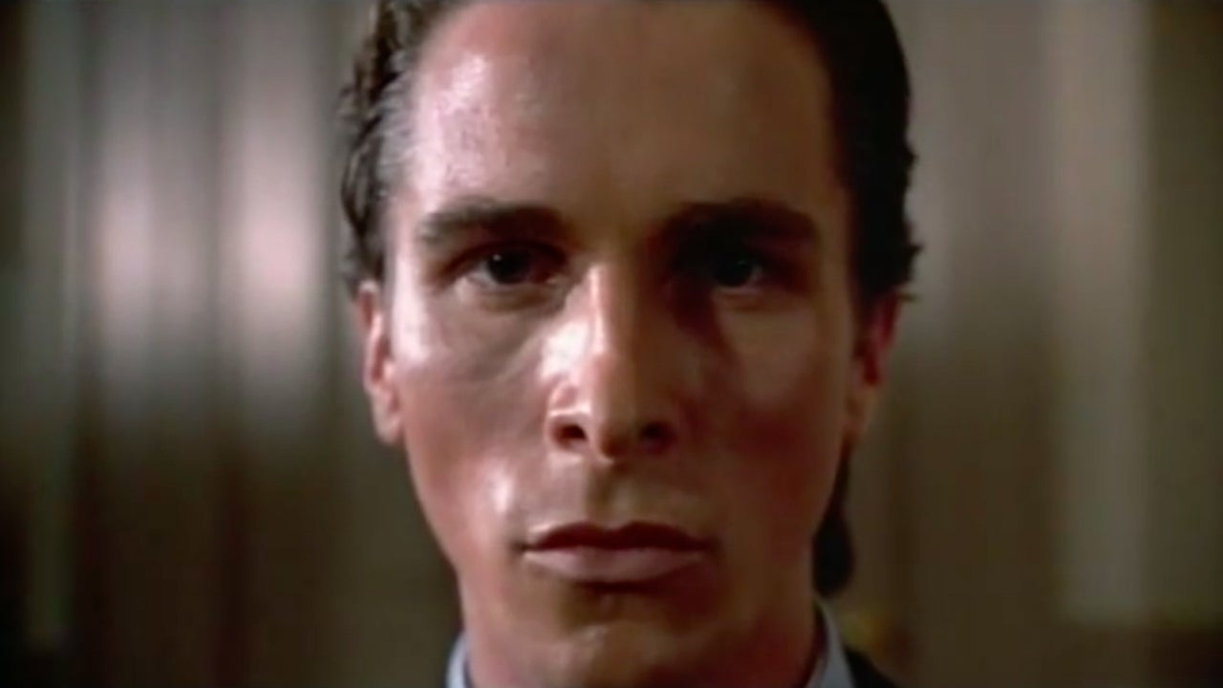
Existential Angst of Patrick Bateman
Abandon hope, all ye who enter here . . .
Notable quotes and paraphrases:
Image source: IGN Video
“Everybody hates their job . . .” (Ellis, 1991)
The
New York City is a pigsty.
“My pain is constant and sharp and I do not hope for a better world for anyone. In fact, I want my pain to be inflicted on others . . .” (Harron, 2000).
“There is an idea of Patrick Bateman, some kind of abstraction—but there is no real me; only an entity, something illusory . . .” (Harron, 2000).
Fear
Even my confession meant nothing . . .
Notes:
Stabbing icon image source: https://town-of-salem.fandom.com/wiki/User:Viliusr
For a purposefully shallow character, the sociopath Patrick Bateman proves to be rather complex. In Bateman’s final monologue, he states, “my pain is constant and sharp and I do not hope for a better world for anyone. In fact, I want my pain to be inflicted on others . . .” (Harron, 2000).

Slide 12
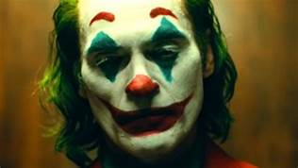
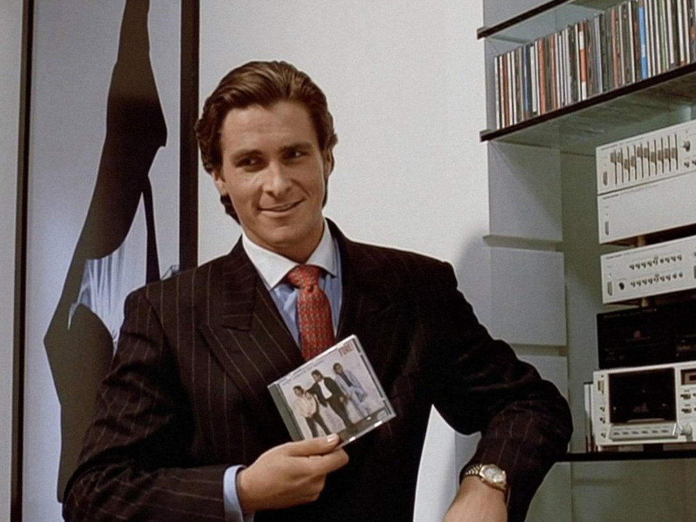
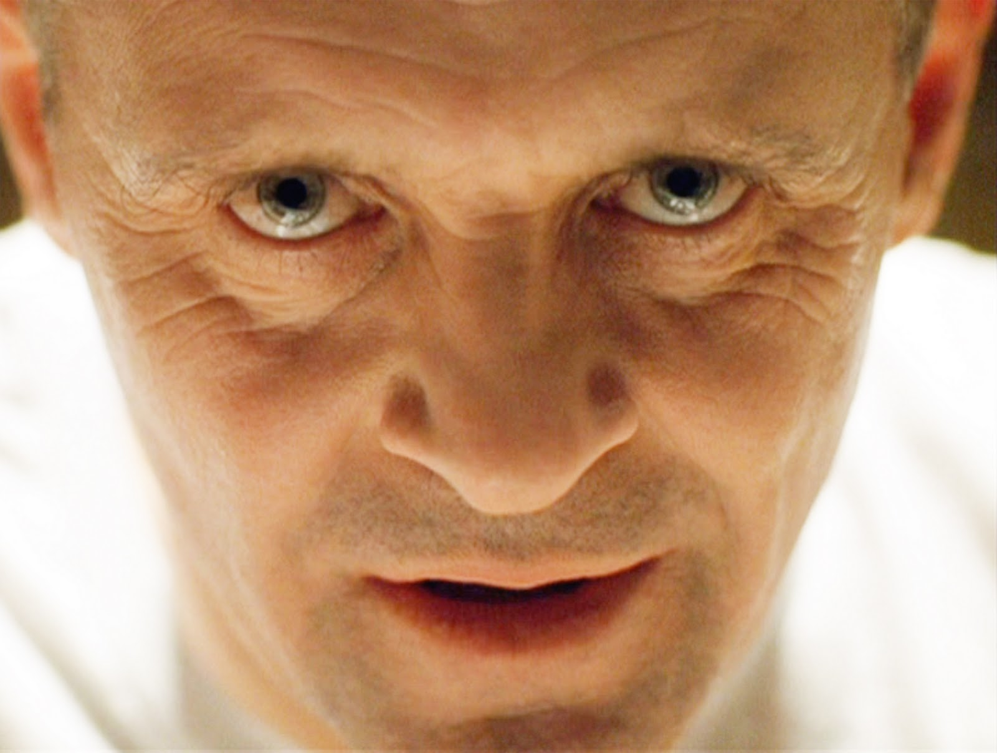
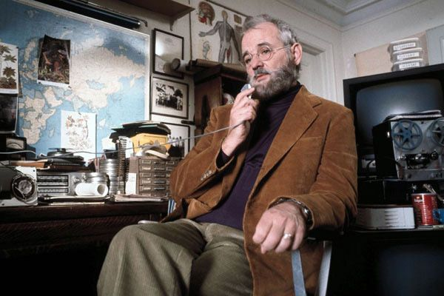
Psychopathy in Cinema: Fact or Fiction?
A prolific study of psychopaths in cinema (Leistedt & Linkowski, 2014)
Patrick Bateman: Primary psychopath: classic/idiopathic typology
Image source: Muse/Edward R Pressman productions
Image: Warner Brothers
The Most Frighteningly Realistic:
Anton Chigurh, No Country For Old Men (2007 film)
Diagnosis: Primary psychopath:
classic/idiopathic typology
Image source: Scott Rudin/Mike Zoss Productions
Runners-up: Gordon Gecko, Wall Street (1987)
Henry Lee Lucas, Henry-Portrait of a Serial Killer (1991)
Scary but not realistic:
Tommy Udo, Kiss of Death (1947)
Norman Bates, Psycho (1960)
Hannibal Lecter, Silence of the Lambs (1991)
Image source: Strong Heart Productions
Image source: Touchstone Pictures
Notable sociopath/psychopaths since the study:
Arthur Fleck/The Joker (2019)
Jordan Belfort/Wolf of Wall Street (2013)
Amy Elliot Dunne/Gone Girl (2014)
Bill Murray as Dr. Raleigh St. Clair, Royal Tenenbaums (2001)
Notes:
In Leistedt and Linkowski’s (2014) prolific study reviewing 126 psychopathic characters from 400 films, the researchers along with senior forensic psychiatrists and cinema critics categorized Patrick Bateman as a primary psychopath of the classic/idiopathic typology, but evidently did not investigate additional diagnoses for Bateman. With a few exceptions, the majority of cinematic psychopaths were judged to be stereotypical villains, unrealistic and sensationalistic. One of the most notable exceptions is the character of Anton Chigurh, portrayed by Javier Bardem in the neo-western psychological thriller, No Country for Old Men (2007), based on the
Cormac McCarthy (2005) novel of the same name.
“Moreover, some of the most famous “psychos” in films are not psychopaths, but psychotics. Well-known examples of these are found in the films Psycho (Norman Bates) and Taxi Driver (Travis Bickel). These characters are, in varying ways, disconnected from reality and suffer from delusional ideation” (Leistedt and Linkowski, 2014, p. 172)

Slide 13
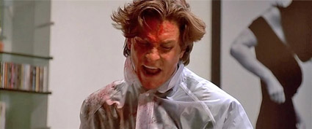
A Good Day to Call in Sick . . .
Good morning, Mr. Farnum. Just calling to let you know you have a new therapy client on your itinerary. Lovely fellow, is the word on the street. Harvard grad, and a highly respectable Wall Street investor I believe, Mr. Patrick .. . Batman, no Bateman, sorry. Sounds super charming on the phone, he does . . .
Rogerebert..com
We’re sorry.
This number is no longer in service . . .
PS: He appears to be kind of a nihilist . . .
Google stock
Notes:
Bloody Patrick Bateman image source: Rogerebert.com

Slide 14
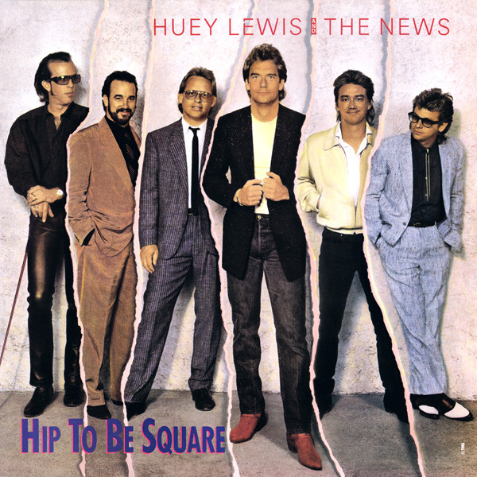
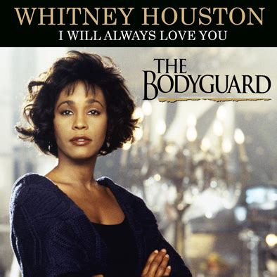
References
American Psychological Association. (2013). Diagnostic and Statistical Manual of
Mental Disorders (5th ed.) https://doi.org/10.1176/appi.books.9780890425596.
Claridge, Gordon, & Brooks, Paul. (1984). Schizotypy and hemisphere function: I. Theoretical considerations and the measurement of
Schizotypy. Personality and Individual Differences, Vol 5(6), 633-648
Cline, V. B. (1996). Pornography and Sexual Addictions. Christian Counseling Today, 4, 58.
Cohen, A.S., Callaway, D.A., Matthews, R.A., Dinzeo, T. (2014). Schizotypal Personality Questionnaire—Brief revised:
Psychometric Replication and Extension. Personality Disorders: Theory, Research and Treatment. 5(1), 32-38.
Dutton, K. (2013). The Wisdom of Psychopaths. Arrow Publishing.
Ellis, B.E. (1991). American Psycho. Vintage Publishing.
Fonseca-Pedrero et al. (2018). Brief assessment of schizotypal traits: a multi-national study. Schizophr Res, 197, 182-191,
doi:10.1016/j.schres.2017.10.043.
Goodman, A. (1990). Addictions, definition and implications. British journal of Addiction. 85, 1403.
Harron, M (Director). (2000). American Psycho [Film]. Edward R. Pressman Productions. Muse Productions.
Irons, R. & Schneider, J.P. (1996). Differential Diagnosis of Sexual Disorders using DSM-IV. Sexual Addiction &
Compulsivity, 3, 7-21.
Notes:
Huey Lewis and the News source image: https://www.discogs.com/release/911255-Huey-Lewis-And-The-News-Hip-To-Be-Square
Genesis Abacab image source: https://www.discogs.com/release/5973584-Genesis-Abacab
Whitney Houston, The Bodyguard image source: https://romantic-moments-songs.blogspot.com/2014/09/whitney-houston-i-will-always-love-you.html
Donald Trump image source: https://www.politico.com/story/2017/12/18/trump-foreign-policy-security-302242

Slide 15
References continued
Leistedt, S.J. & Linkowski, P. (2014). Psychopathy and the Cinema: Fact of Fiction? Journal of Forensic
Science, 59(1), 167-174. doi: 10.1111/1556-4029.12359
Marco, C.A. & Vaughan, J. (2005). Emergency Management of Agitation in Schizophrenia. American Journal of
Emergency Medicine, 23(6), 767-76.
doi:10.1016/j.ajem.2005.02.050. PMID: 16182986.
Neumann CS, Hare RD, Newman JP. (2007). The superordinate nature of the psychopathy
checklist-revised. Journal of Personality Disorders. 21(2):102-17.
doi: 10.1521/pedi.2007.21.2.102.
Pomeroy, E. (2015). The clinical assessment workbook: Balancing strengths and differential diagnosis (2nd ed.). Cengage Learning
Robinson, D. (2006). The Unattainable Narrative: Identity, consumerism, and the slasher film in Mary Harron’s American Psycho.
CineAction, 68, 26.
[Stalinsurfstheweb]. (2010, August 17). American Psycho –homeless guy gets stabbed [Video].
YouTube:.https://www.youtube.com/watch?v=NY3yzLA-g24
Notes:
Huey Lewis and the News source image: https://www.discogs.com/release/911255-Huey-Lewis-And-The-News-Hip-To-Be-Square
Genesis Abacab image source: https://www.discogs.com/release/5973584-Genesis-Abacab
Whitney Houston, The Bodyguard image source: https://romantic-moments-songs.blogspot.com/2014/09/whitney-houston-i-will-always-love-you.html
Donald Trump image source: https://www.politico.com/story/2017/12/18/trump-foreign-policy-security-302242

