Slide 1
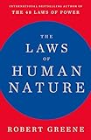
The Laws of Human Nature summary
This Photo by Unknown Author is licensed under CC BY
Michael V farnum

Slide 2
Notes:
The Laws of Human Nature by Robert Greene (Detailed Summary) (youtube.com)

Slide 3
The Laws of Human Nature
Law 1: The Law of Irrationality
Law 2: The Law of Narcissism
Law 3: The Law of Role playing
Law 4: The Law of Compulsive Behavior
Law 5: The Law of Covetousness
Law 6: Law of Short-sightedness
Law 7: Law of Defensiveness
Law 8: The Law of Sabotage
Law 9: The Law of Repression

Slide 4
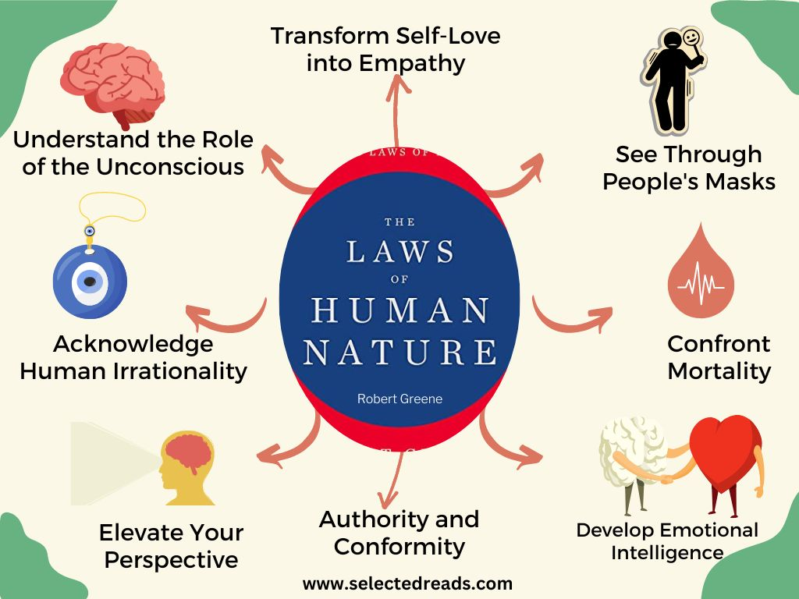

Slide 5
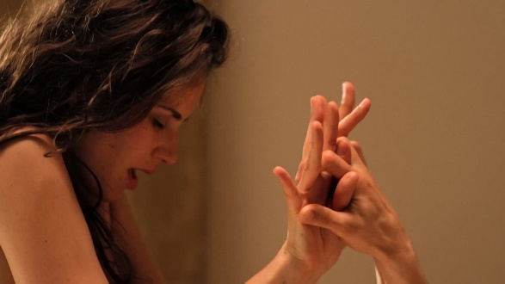
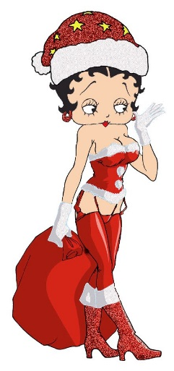
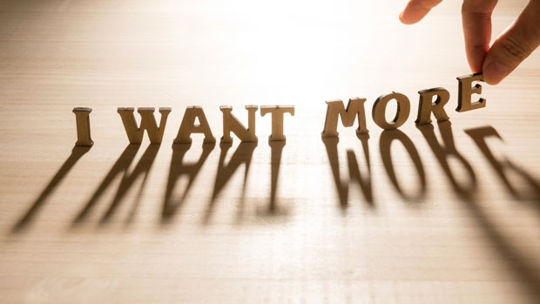
The Laws of Human Nature: Intro
The most common human emotion is the desire for pleasure and the avoidance of pain.
The author suggests this pleasure principle in our thinking is the basis for all of our mental biases.

Slide 6
Notes:
The World of JACONNI: 07.2014
Eve in the Garden of Eden
Painting + Photo Manipulation of Eve in the Garden of Eden ready to take a bite out of Original Sin. Always liked that fruit / apple metaphor. The piece is pretty lateral with only has two layers of depth, but the snake has some dimension [was my favorite part to work on]. Take look at its slithery tongue just barely touching Eve's fingertip as it eggs her temptation on with its hisses. I tried to shy away from being cliche...not sure how that worked out. I also didn't want Eve to be associated with any specific race, so kept her ambiguous.

Slide 7
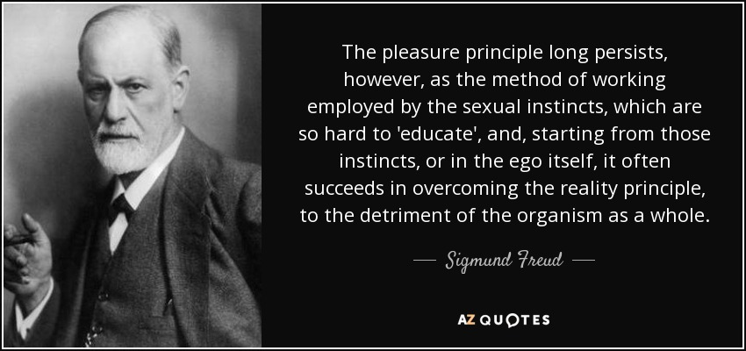
Translation: Pleasure good, pain bad. Humans often choose a false reality of pleasure (illusion) over the true reality of things.

Slide 8
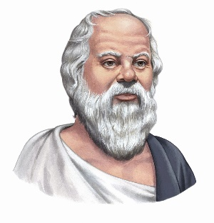
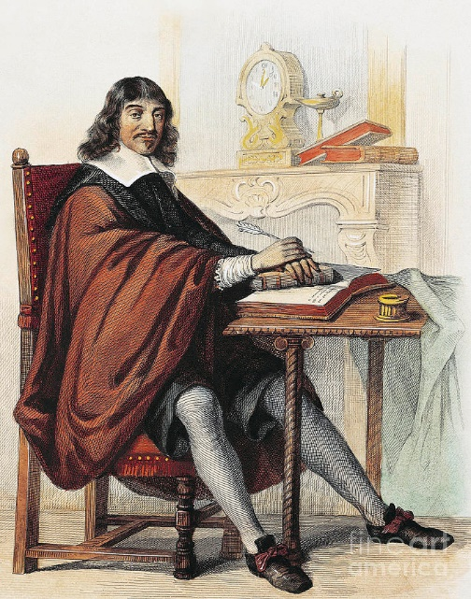
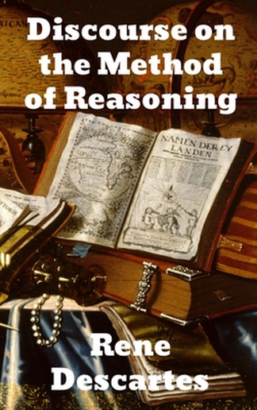
Law 1: The Law of Irrationality
Know
Thyself . . .
Controlling one’s emotions
and engaging rationality
are the keys to self-awareness, understanding others &
self mastery.

Slide 9
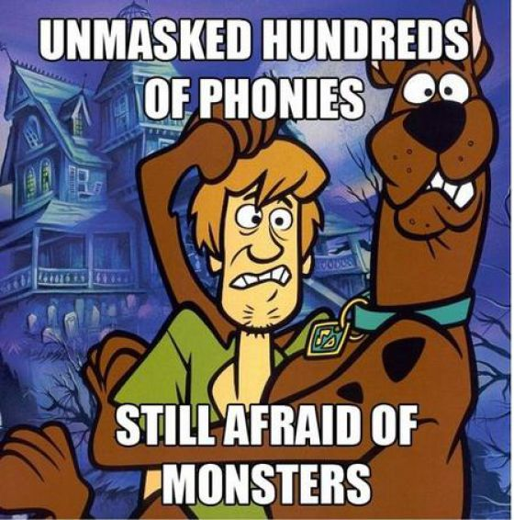

Slide 10
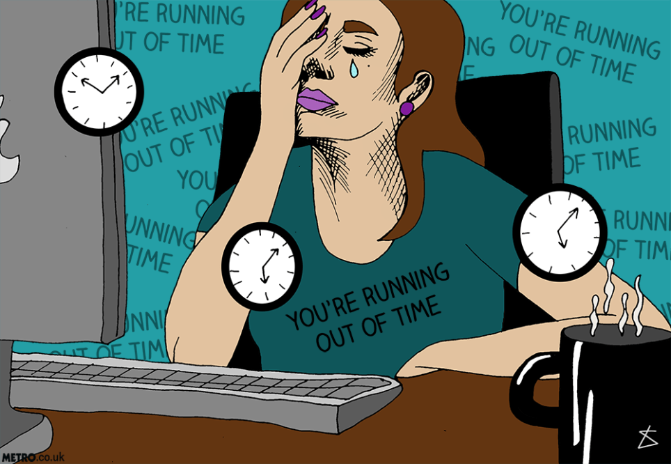
Npbody told girlfriend time is an illusion . . .

Slide 11
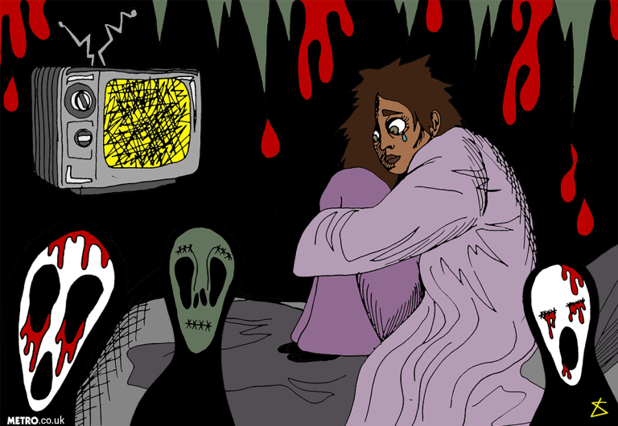
What if the zombies come/what if the world just ends/what if gravity stops and you fall into space?

Slide 12
Law 1: The Law of Irrationality
Humans are mostly unaware of how deeply their emotions & desires rule their daily lives, choices and beliefs. The first step to rationality is realizing irrational we humans really are. When we control our emotions through mindfulness and self awareness, we are in control of our own choices and our destiny.
Irrationality results largely due to a miscommunication between the limbic brain which regulates feelings and emotion and the neo-cortex, which controls cognition and language. Additionally, trauma and other negative emotions can activate our ancient reptilian brain, engaging the flight or fight response, inhibiting rational thinking.
We Humans often dwell on our fears, making them greater than they are. Long-term anxiety infects our thinking which in turn affects our behavior.
Step 1: Recognize your biases.

Slide 13
Confirmation bias: Seeking evidence to confirm an idea we
already believe in while ignoring opposing or contradicting ideas.
Counteract this bias by playing devil’s advocate and considering opposing views.
Conviction bias: The inability to see the flaws in one’s belief simply because our conviction is so strong.
Counteract by realizing that conviction/belief does not equal truth. All things are subjective and relative. Realize how limited your perceptions may be.
Appearance bias: Because something looks good, we assume it is all good. Counteract: Search deeper, consider all the facts.
Blame bias: Our innate sense is to blame others.
Take responsibility for everything you do.

Slide 14
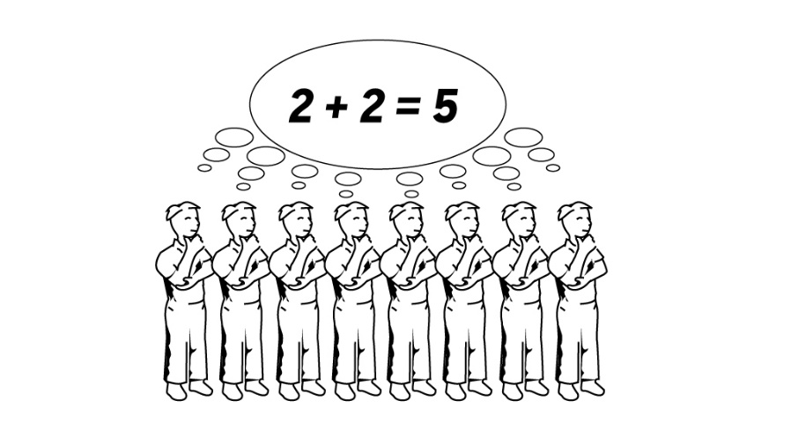
This Photo by Unknown Author is licensed under CC BY
Group bias: Everybody’s doing it, so it must be okay. We seek others who think the same way we do and those who affirm our beliefs.
Counteract: What’s popular is not true, what’s true is not popular.
Follow your own path.
Superiority bias: We all like to think of ourselves as rational, ethical, reasonable and likable.
If that were , true why don’t we have world peace and a much more rational world?

Slide 15
Instigating Irrationality
The following is just a short list of things that may instigate or inflame your irrationality.
Past experience/painful past learning.
Sudden losses or gains.
Stress/pressure
Group think/peer pressure
Fear, which is at the root of most negative emotions

Slide 16
Law 2: The Law of Narcissism
Narcissism:
Narcissistic personality disorder is a mental health
condition in which people have an unreasonably high
sense of their own importance. They need and seek too
much attention and want people to admire them.
People with this disorder may lack the ability to understand or care about the feelings of others. But behind this mask of extreme confidence, they are not sure of their self-worth and are easily upset by the slightest criticism.

Slide 17
Law 2: The Law of Narcissism
Transform self-love into empathy.
Some people will do anything for attention.
Even negative attention is better than being ignored for most.
We overcome narcissism by developing empathy and compassion for others. Don’t attempt to mind-read or make assumptions about others. Seek to understand the other before being understood. Pay attention to body language and tone of voice.

Slide 18
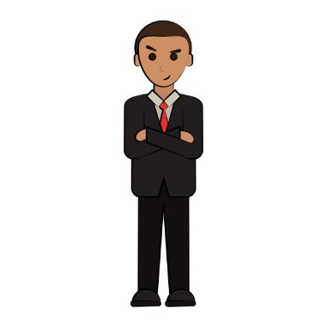
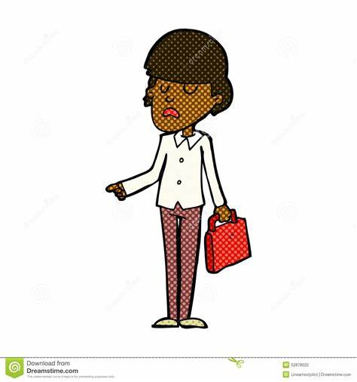
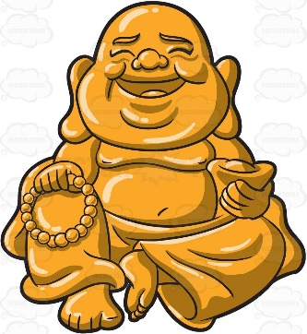
Where are you on the Narcissist scale?
The complete control narcissist may be the most insecure but also the most controlling and manipulative.
The theatrical narcissist is a drama queen who enjoys playing the victim.
The healthy narcissist makes a great leader.
Deep Narcissism
Functional
Empathy
Self-righteous and self-absorbed
vengeance-seeking
You like attention
If it comes your way.
World peace is all
That matters.

Slide 19
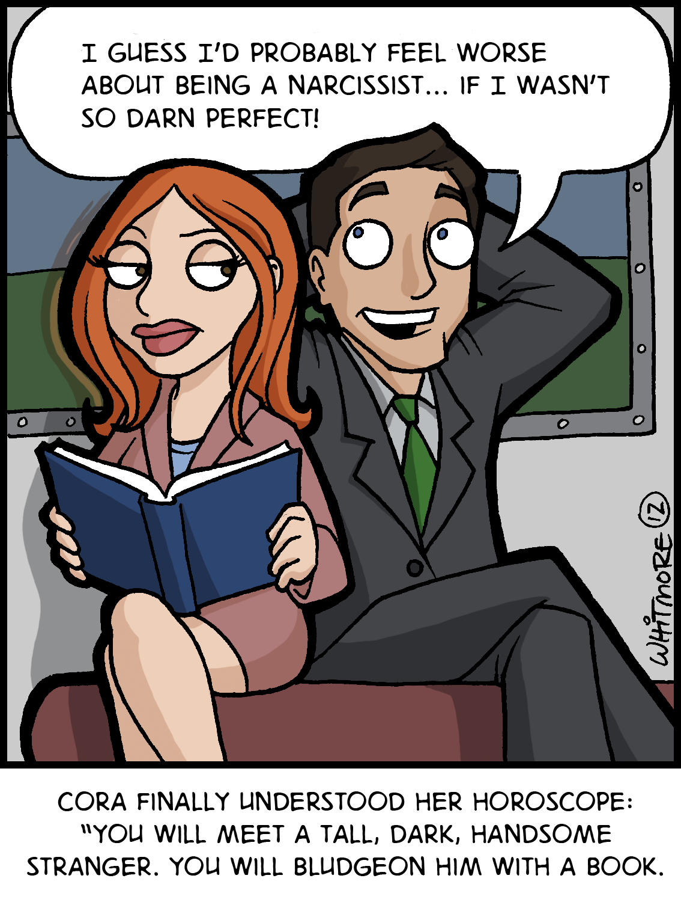

Slide 20
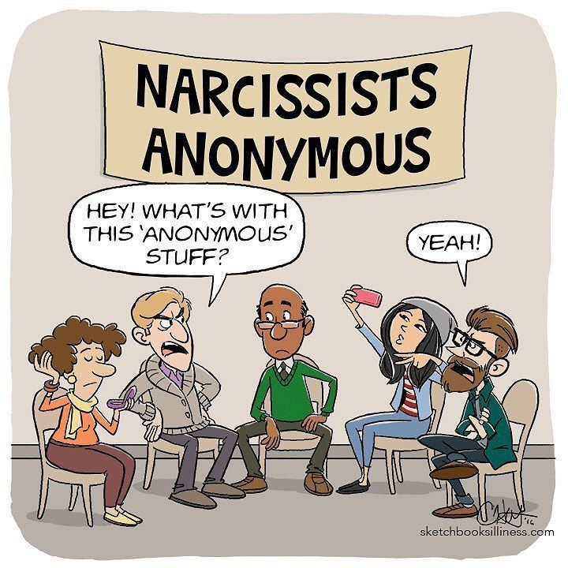

Slide 21
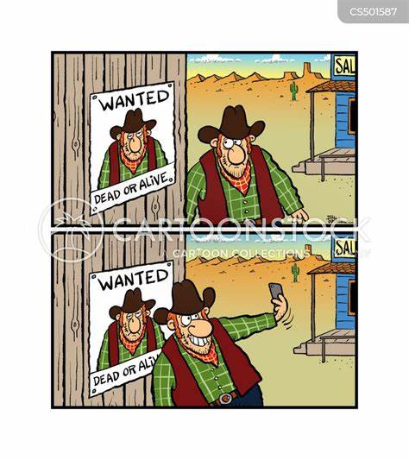

Slide 22
I don’t like that man . . .
I must get to know him better.
--Abraham Lincoln

Slide 23
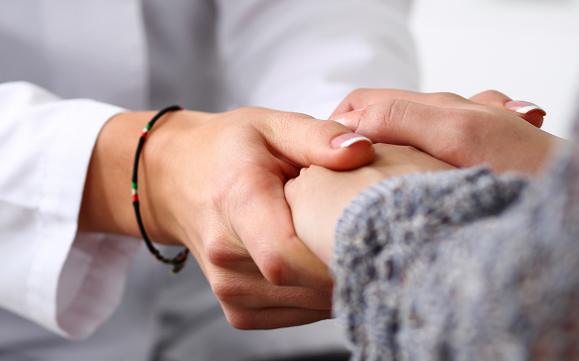
Empathy
Understand that developing empathy is a process.
Empathy is a state of mind, a different way to relate to people.
Developing empathy requires asking for and considering feedback from others.
Avoiding or rejecting those who rub you the wrong way is not helpful in attaining greater empathy.

Slide 24
Notes:
Jingle Baby | Truth Tellers | Liberty Mutual Insurance Commercial (youtube.com)

Slide 25
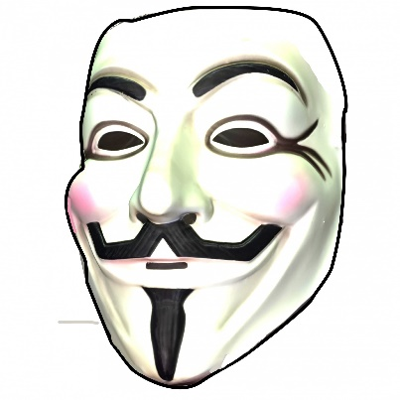
Law 3: The Law of Role Playing
We all wear masks to create our identity and to function in the world.
In Jungian psychology this is known as the persona.
Masks often hide our true feelings and emotions but we all have cracks in our masks, our true intentions and feelings revealed by body language, tone of voice, facial expressions, Freudian slips, and the negative emotions we display at times.
Understand how a person functions under normal conditions vs. how they function under stress.

Slide 26
People are like the moon . . .
They only show you one of their sides . . .
--Arthur Schopenhauer

Slide 27
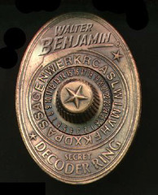
Decoding Keys: Seeing Past the Mask
Key 1: Identify like/dislike cues in body language, tension, tone of voice, eye contact, fake vs. genuine smiles
Key 2: Dominance vs. submission cues
Key 3: Deception cues, micro-clues in expression
This Photo by Unknown Author is licensed under CC BY-NC-ND

Slide 28
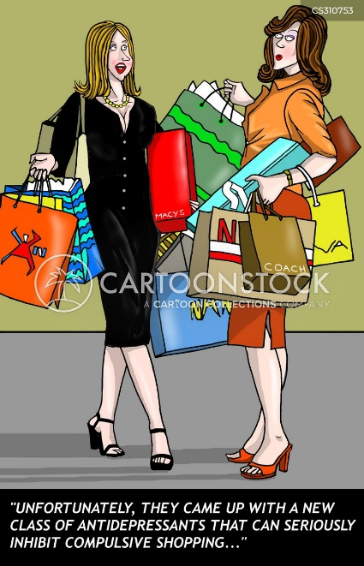
Law 4: The Law of Compulsive Behavior
We can measure the quality of a person’s characer by:
How well one handles adversity
Their ability to work with others
Their patience
Their willingness to learn

Slide 29
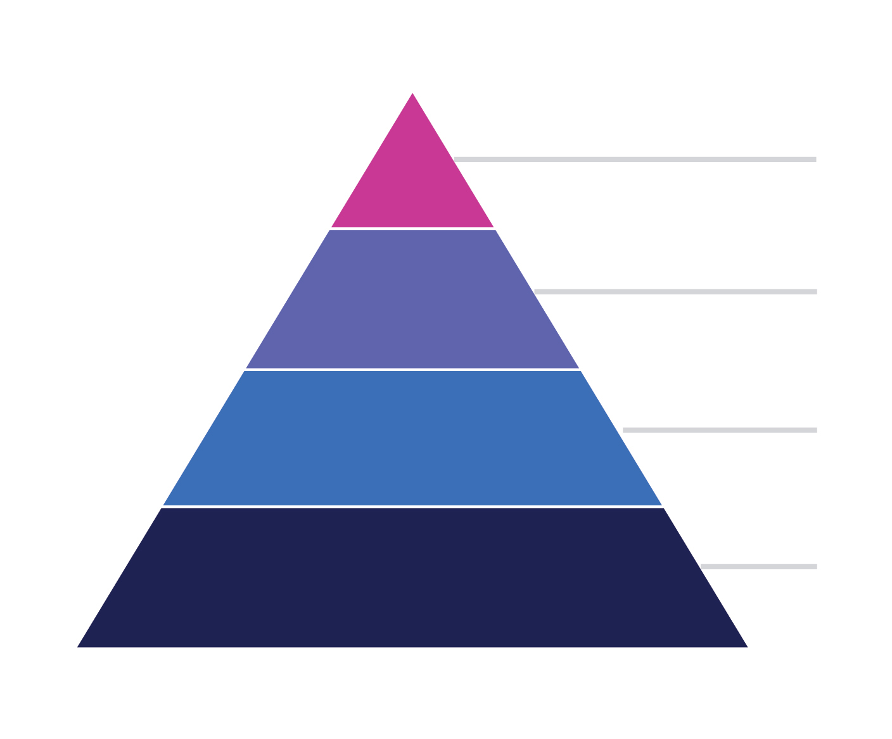
Weak
Unreliable
Impatient
Intolerant
Untrust-worthy
Needy
Strong
Dependable
Persistent
Patient
Tolerant
Character
Intelligence
Reputation
Beauty

Slide 30
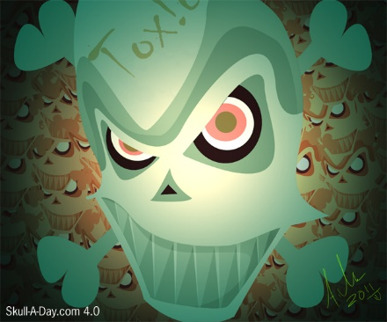
Toxic Character Types
The Hyperperfectionist
Relentless Rebel
The Personalizer
The Drama Magnet
The Big Talker
The Sexualizer
This Photo by Unknown Author is licensed under CC BY-NC-ND
The Pampered Prince/Princess
The Moralizer

Slide 31
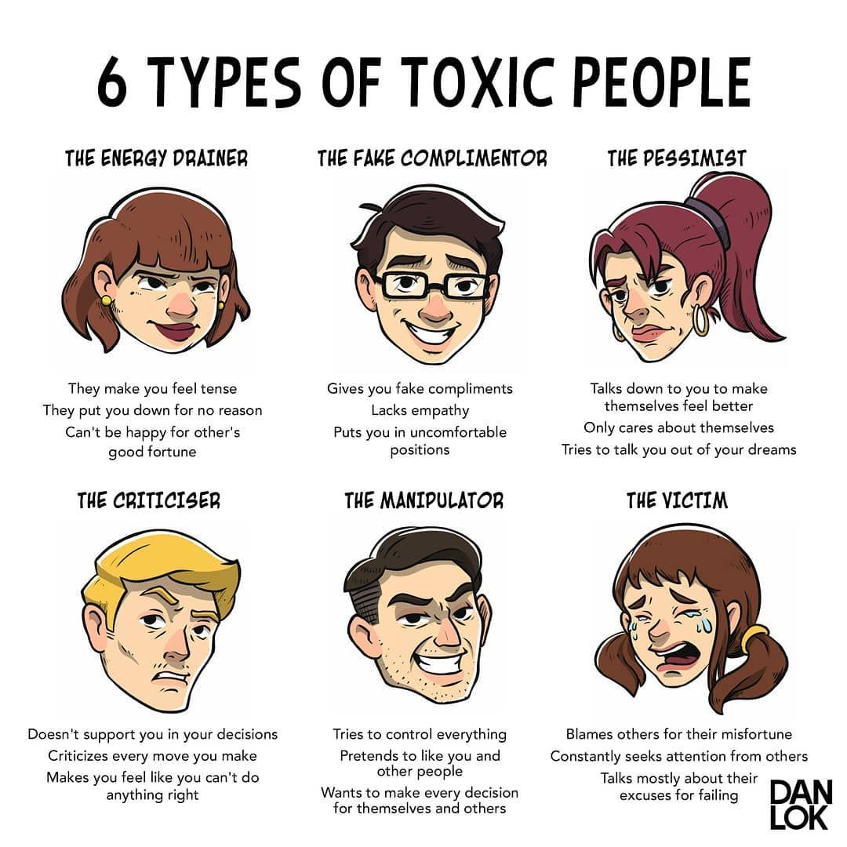

Slide 32
Notes:
hw_introdungeonrooms40z_h_all_97 (youtube.com)

Slide 33
Law 5: The Law of Covetousness
Humans are marked by a natural desire to covet or obtain what they do not have.
Most people are secretly voyeurs, desiring to peek into the inner world of others.
Tell someone they cannot have something, and they will instantly desire it.
Desire is more powerful than possession.
Notes:
I Do Not Want What I Haven't Got (2009 Remaster) (youtube.com)

Slide 35
Law 6: The Law of Short-sightedness
Everything is about perspective.
Are you standing at the base of the mountain? Or the peak?
There are unintended consequences.
We can get lost in the tactics and in trivialities.
Don’t succumb to FOMO (ticker tape fever.)

Slide 36
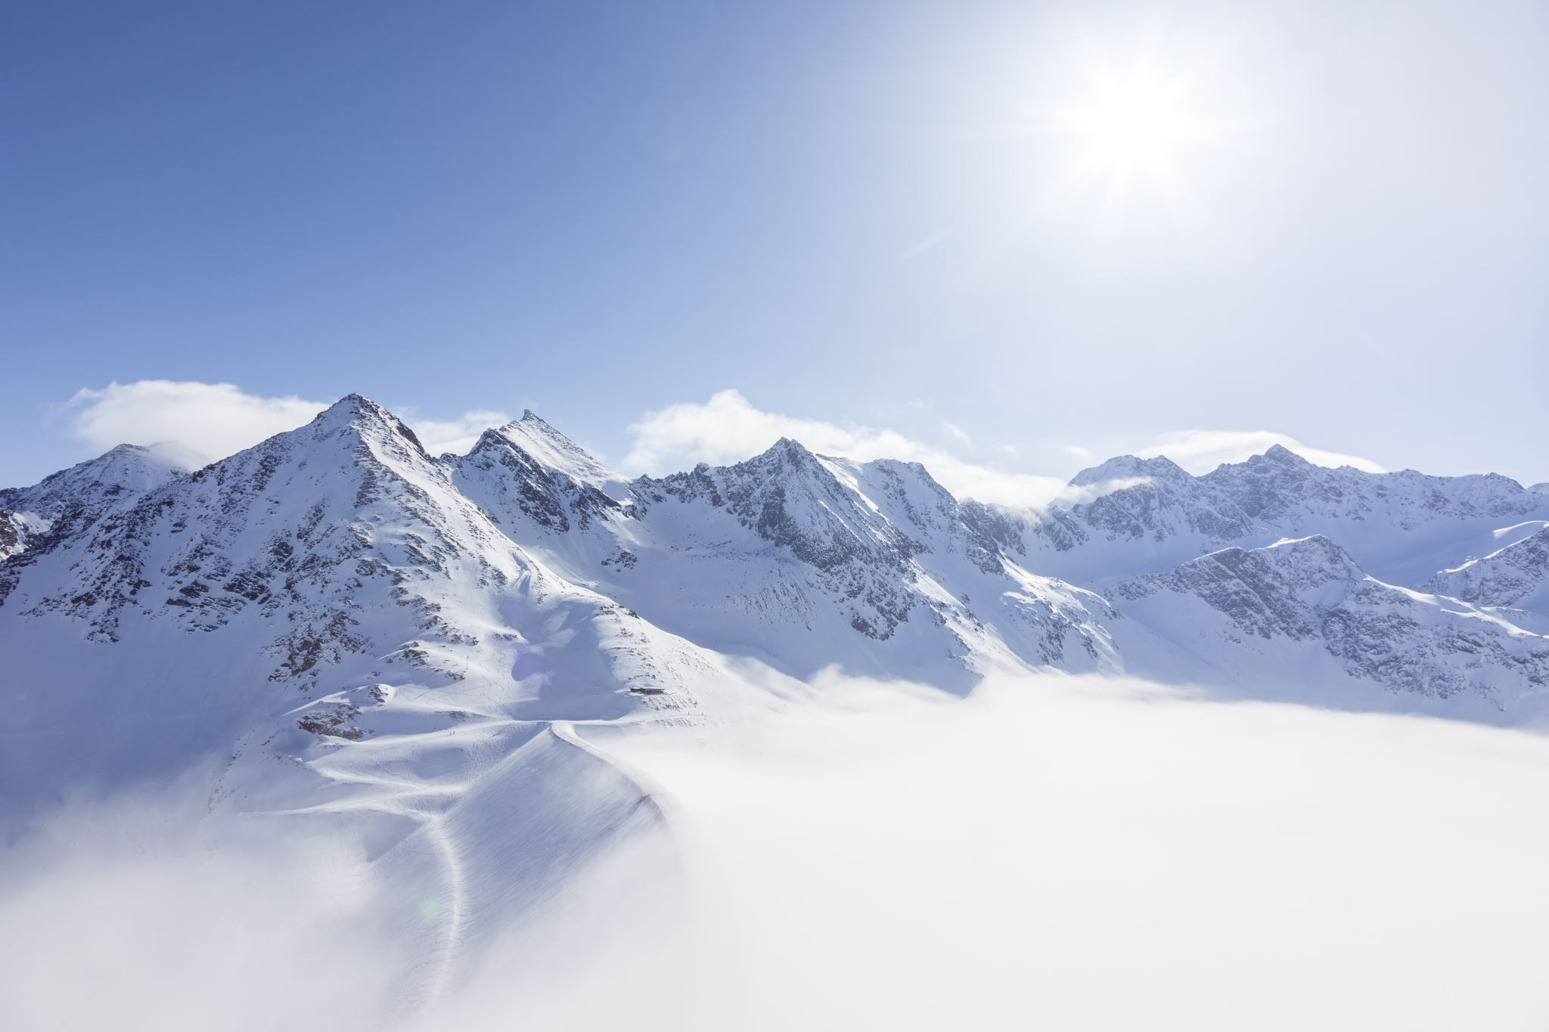
Widen Your Perspective
To see the far-ranging
consequences of your decisions . . .

Slide 37
Law 7: The Law of Defensiveness
On the Nature of universal self opinions:
“I am autonomous, acting of my own free will.”
--When we are coerced, we tend to rebel.
“I am intelligent in my own way.”
==No one wants to believe they are actually stupid.
“I am basically good and decent.”
--Really???

Slide 38
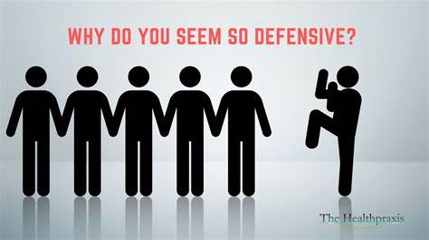
Sage Advice: Never put someone on the defensive about their self-beliefs . . .

Slide 39
Strategies to avoid putting someone on the defensive:
Become a great listener. (Everyone is more interested in their own selves.)
Treat everyone as uncharted territory.
Make them feel comfortable, subtly.
Confirm their self opinion.
Ally their insecurities. Flattery will get you everywhere.
Use their resistance or stubbornness in a constructive way.
Realize that most old people are more inflexible.
Distance yourself from your own self beliefs.

Slide 40
Law 8: The Law of Self-Sabotage
Change your circumstances, change your attitude . . .
Change your attitude, change your circumstances . . .
You must be aware not only of the role of your attitude, but
In its supreme power to improve your circumstances.
Narrow vs. Expansive attitudes
Narrow = Fearful, limiting, negative

Slide 41
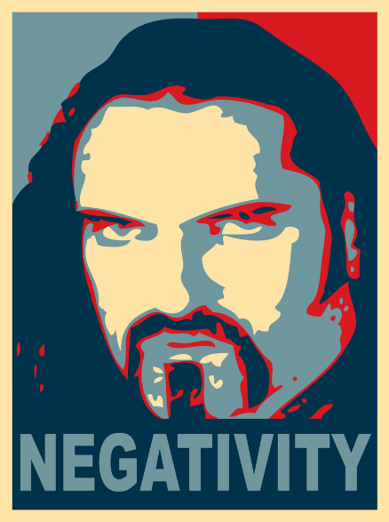
Negative Attitudes to Conquer
Hostility
Jealousy
Avoidance
Anxiety
Resentful
Depressive
This Photo by Unknown Author is licensed under CC BY-SA

Slide 42
Notes:
Into the fold: Advanced layouts | Wix Studio (youtube.com)

Slide 43
Law 9: The Law of Repression
Confronting Your Dark Side
This Photo by Unknown Author is licensed under CC BY-NC
Signs that your Shadow is showing:
Emotional outbursts
Acting the opposite of how you feel (reaction formation)
Hypocrisy
Vehement denial Projection (projecting
Over-idealization your stuff onto others)
Accidental behavior

Slide 44
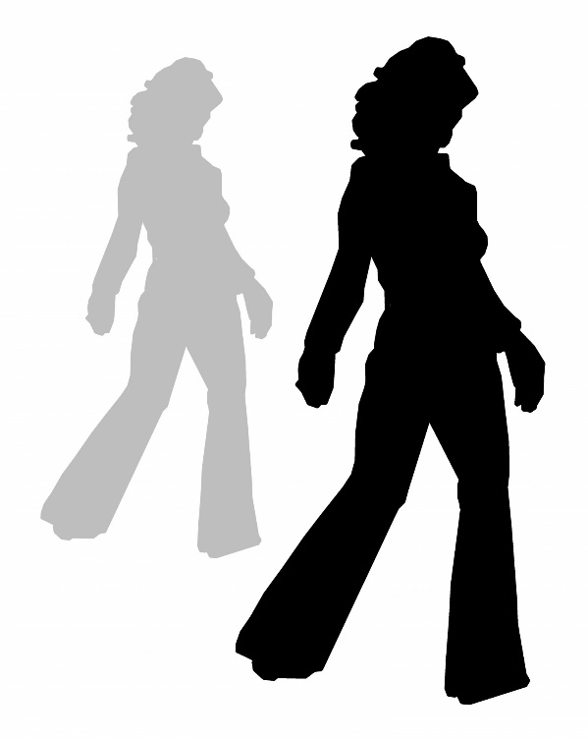
Common emphatic traits (covers) The tough guy The saint The fanatic Passive-aggressive charmer Rigid rationalist The snob

Slide 45
Notes:
TTR Tony Beach Full 16x9 Raw Subs V3 (youtube.com)

Slide 46
The average person
cannot function
in the face of
intangible forces
--Manly P Hall

Slide 47
Notes:
The Secret Powers & Unseen Forces - Manly Palmer Hall (youtube.com)

